Slide 1
Circular business cases – Low-hanging fruit becomes a circular network within the city
Arne Rossel
17/11/2022
Economic House of Ostend

Slide 2
Approach
Waste stream analysis
30 telephone surveys (Vives)
70 on site visits
Observation
Small amounts of recyclable waste – frequency
Not collected due to small quantity
Economic House facilitates logistic support (intermediary)
Detect existing actions

Slide 3
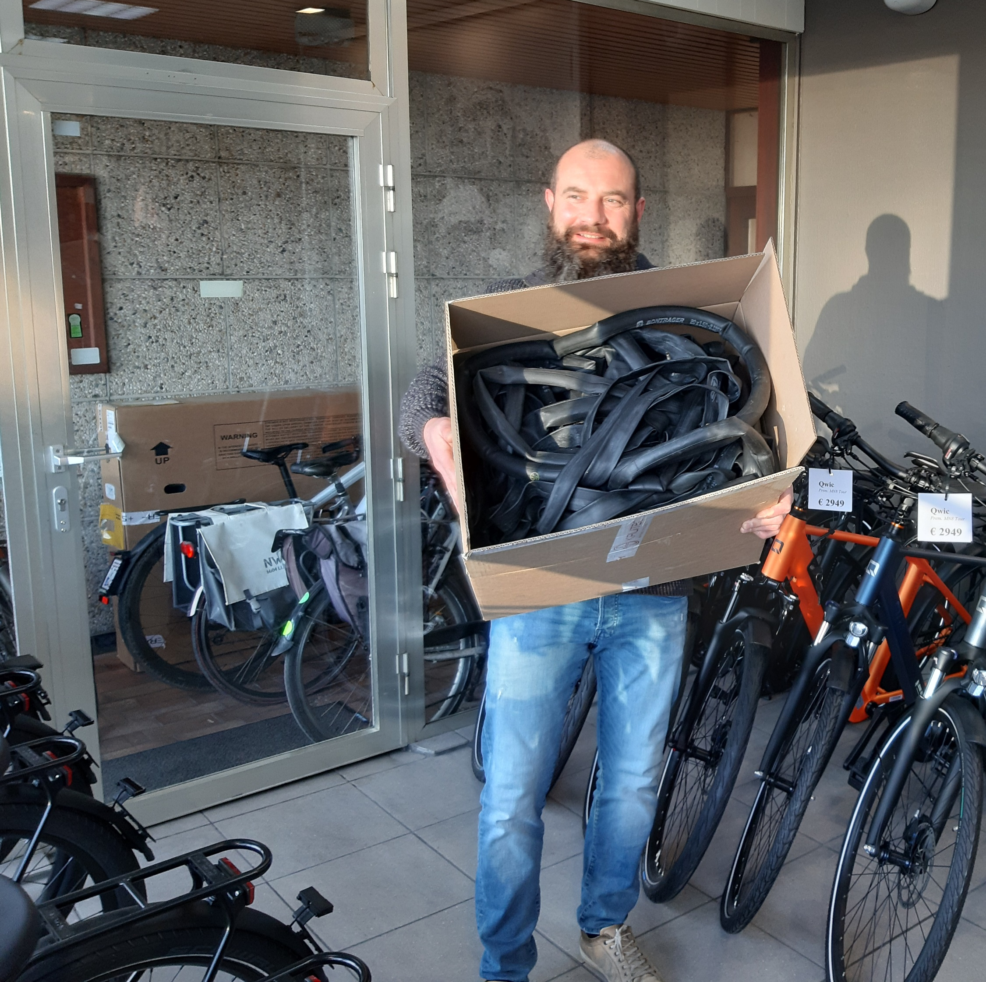
1) Bicycle tires
Schwalbe
Inner tubes
7 stores
Skelter/Go carts
Outer tubes

Slide 4
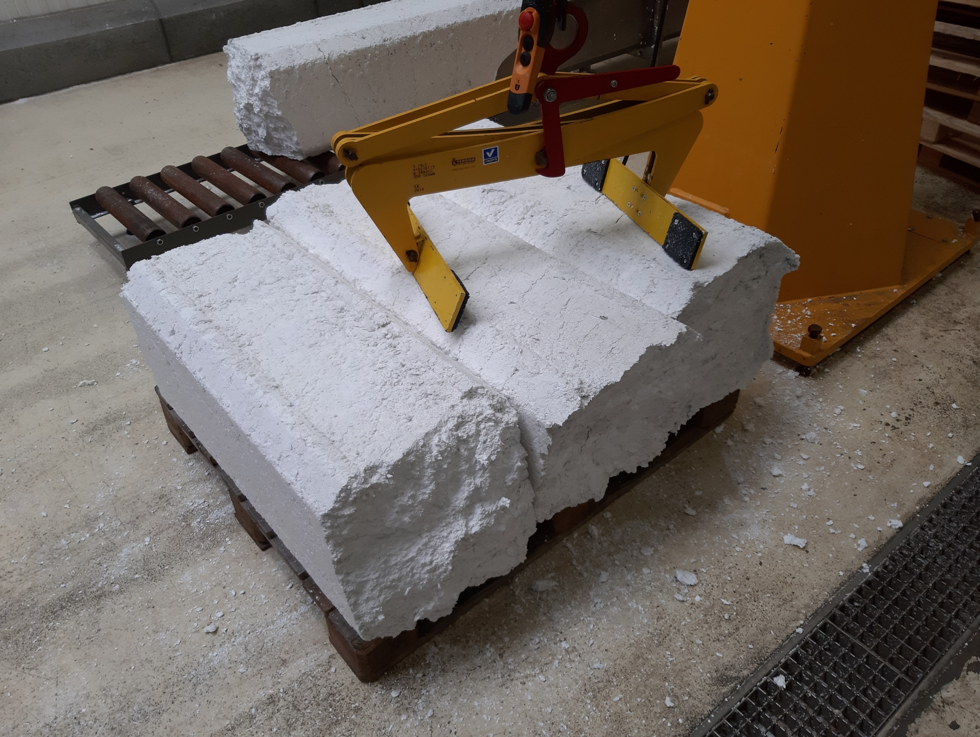
2) Styrofoam
Collection and
processing: social economy
Reducing residual waste

Slide 5
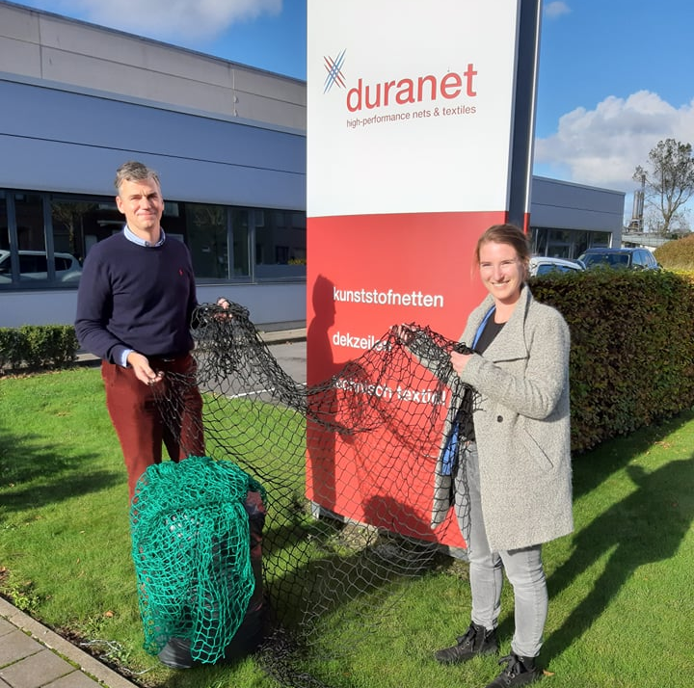
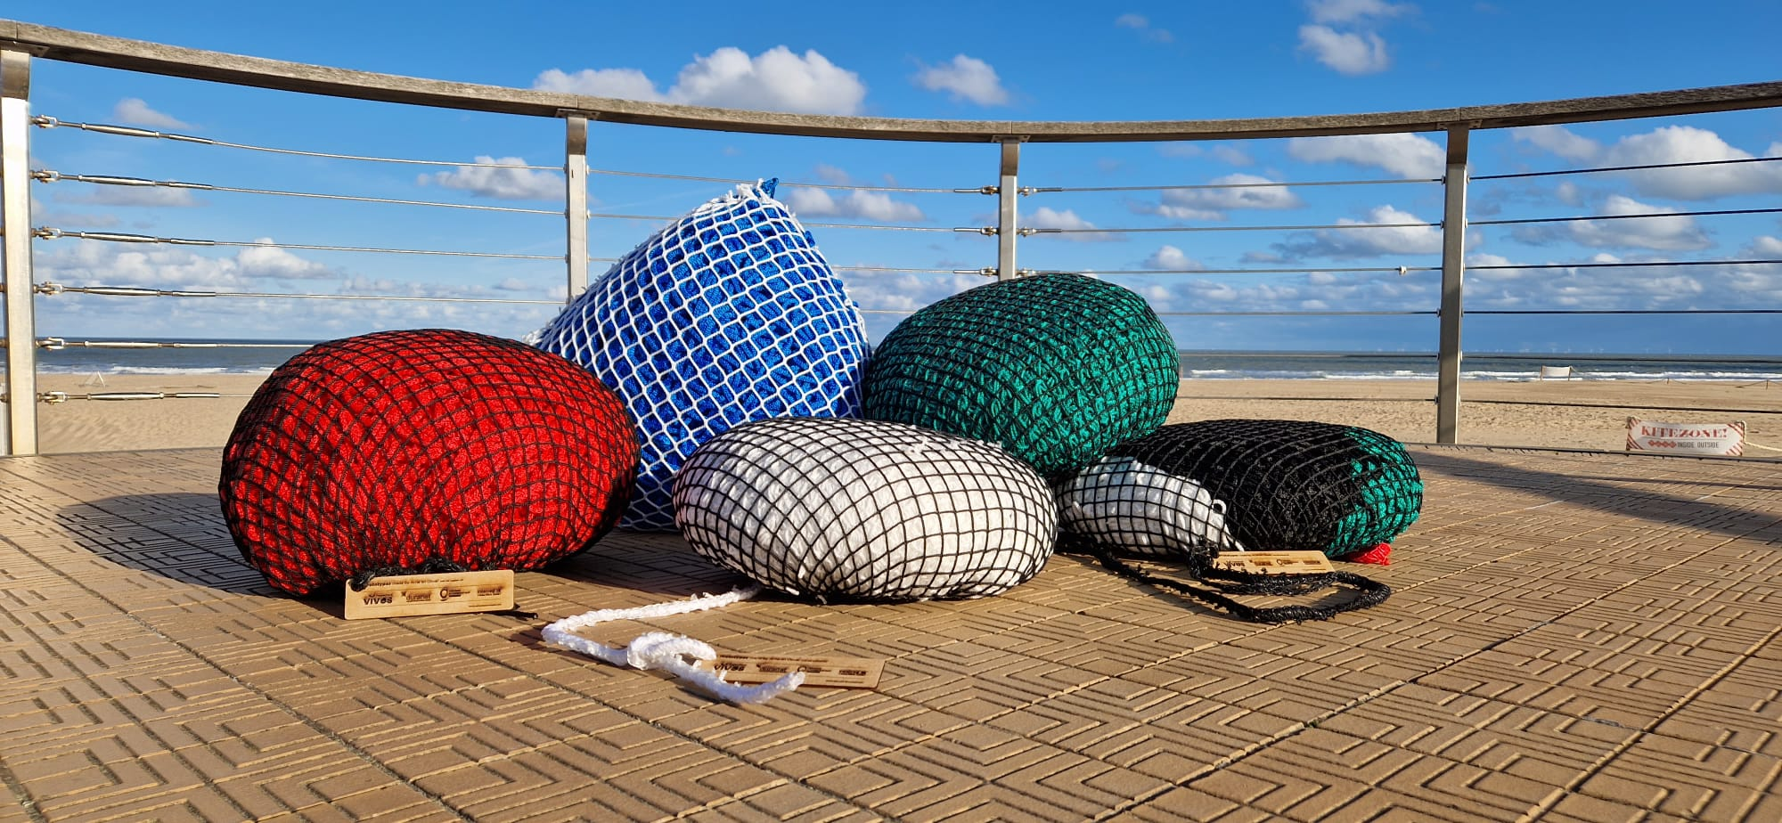
3) Nets
Own business case
Try-out library
Social economy

Slide 6
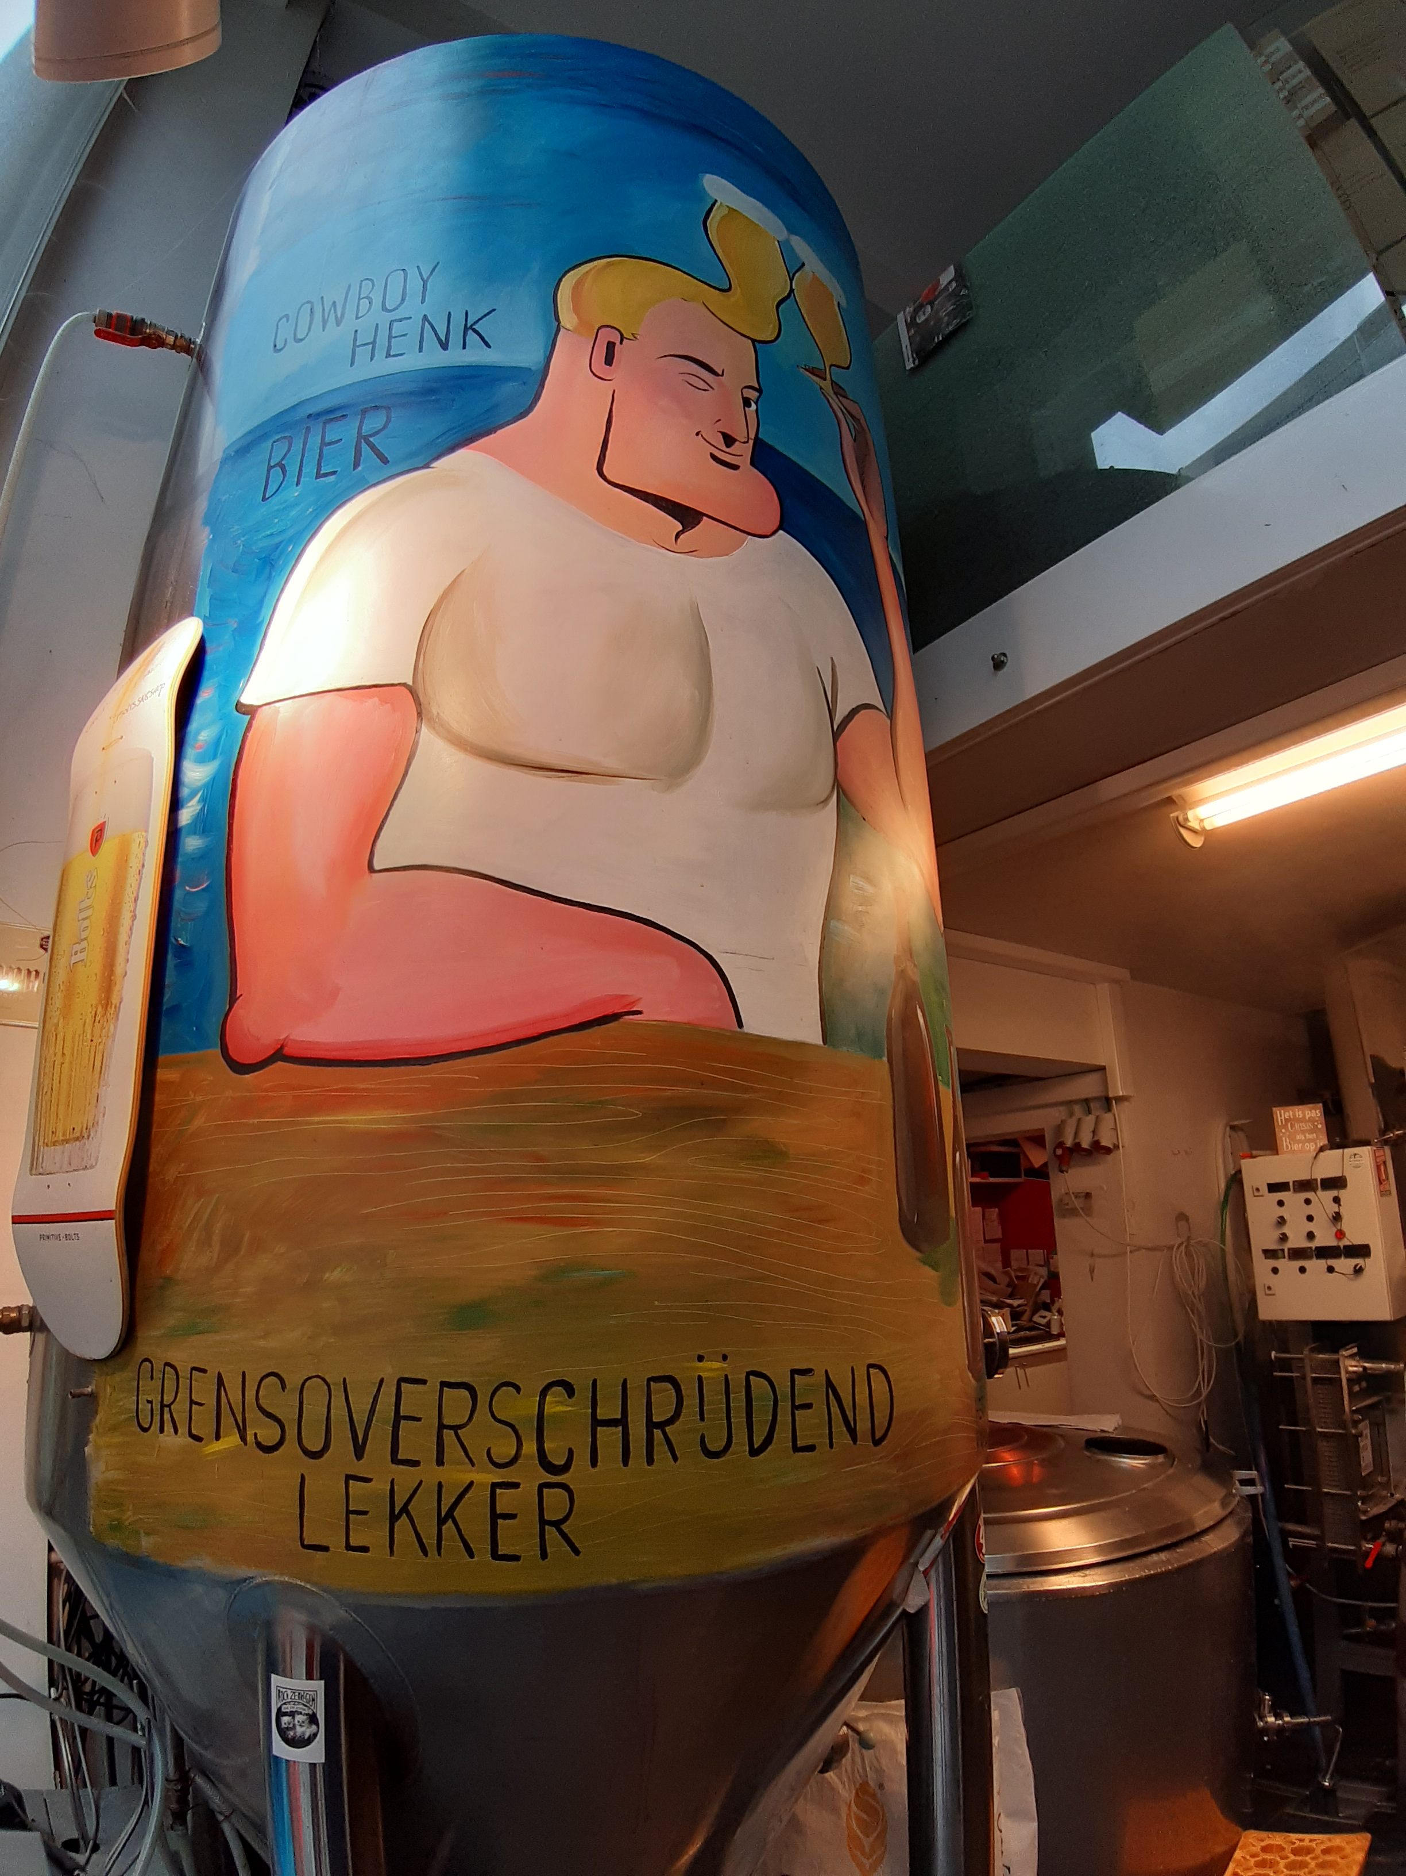
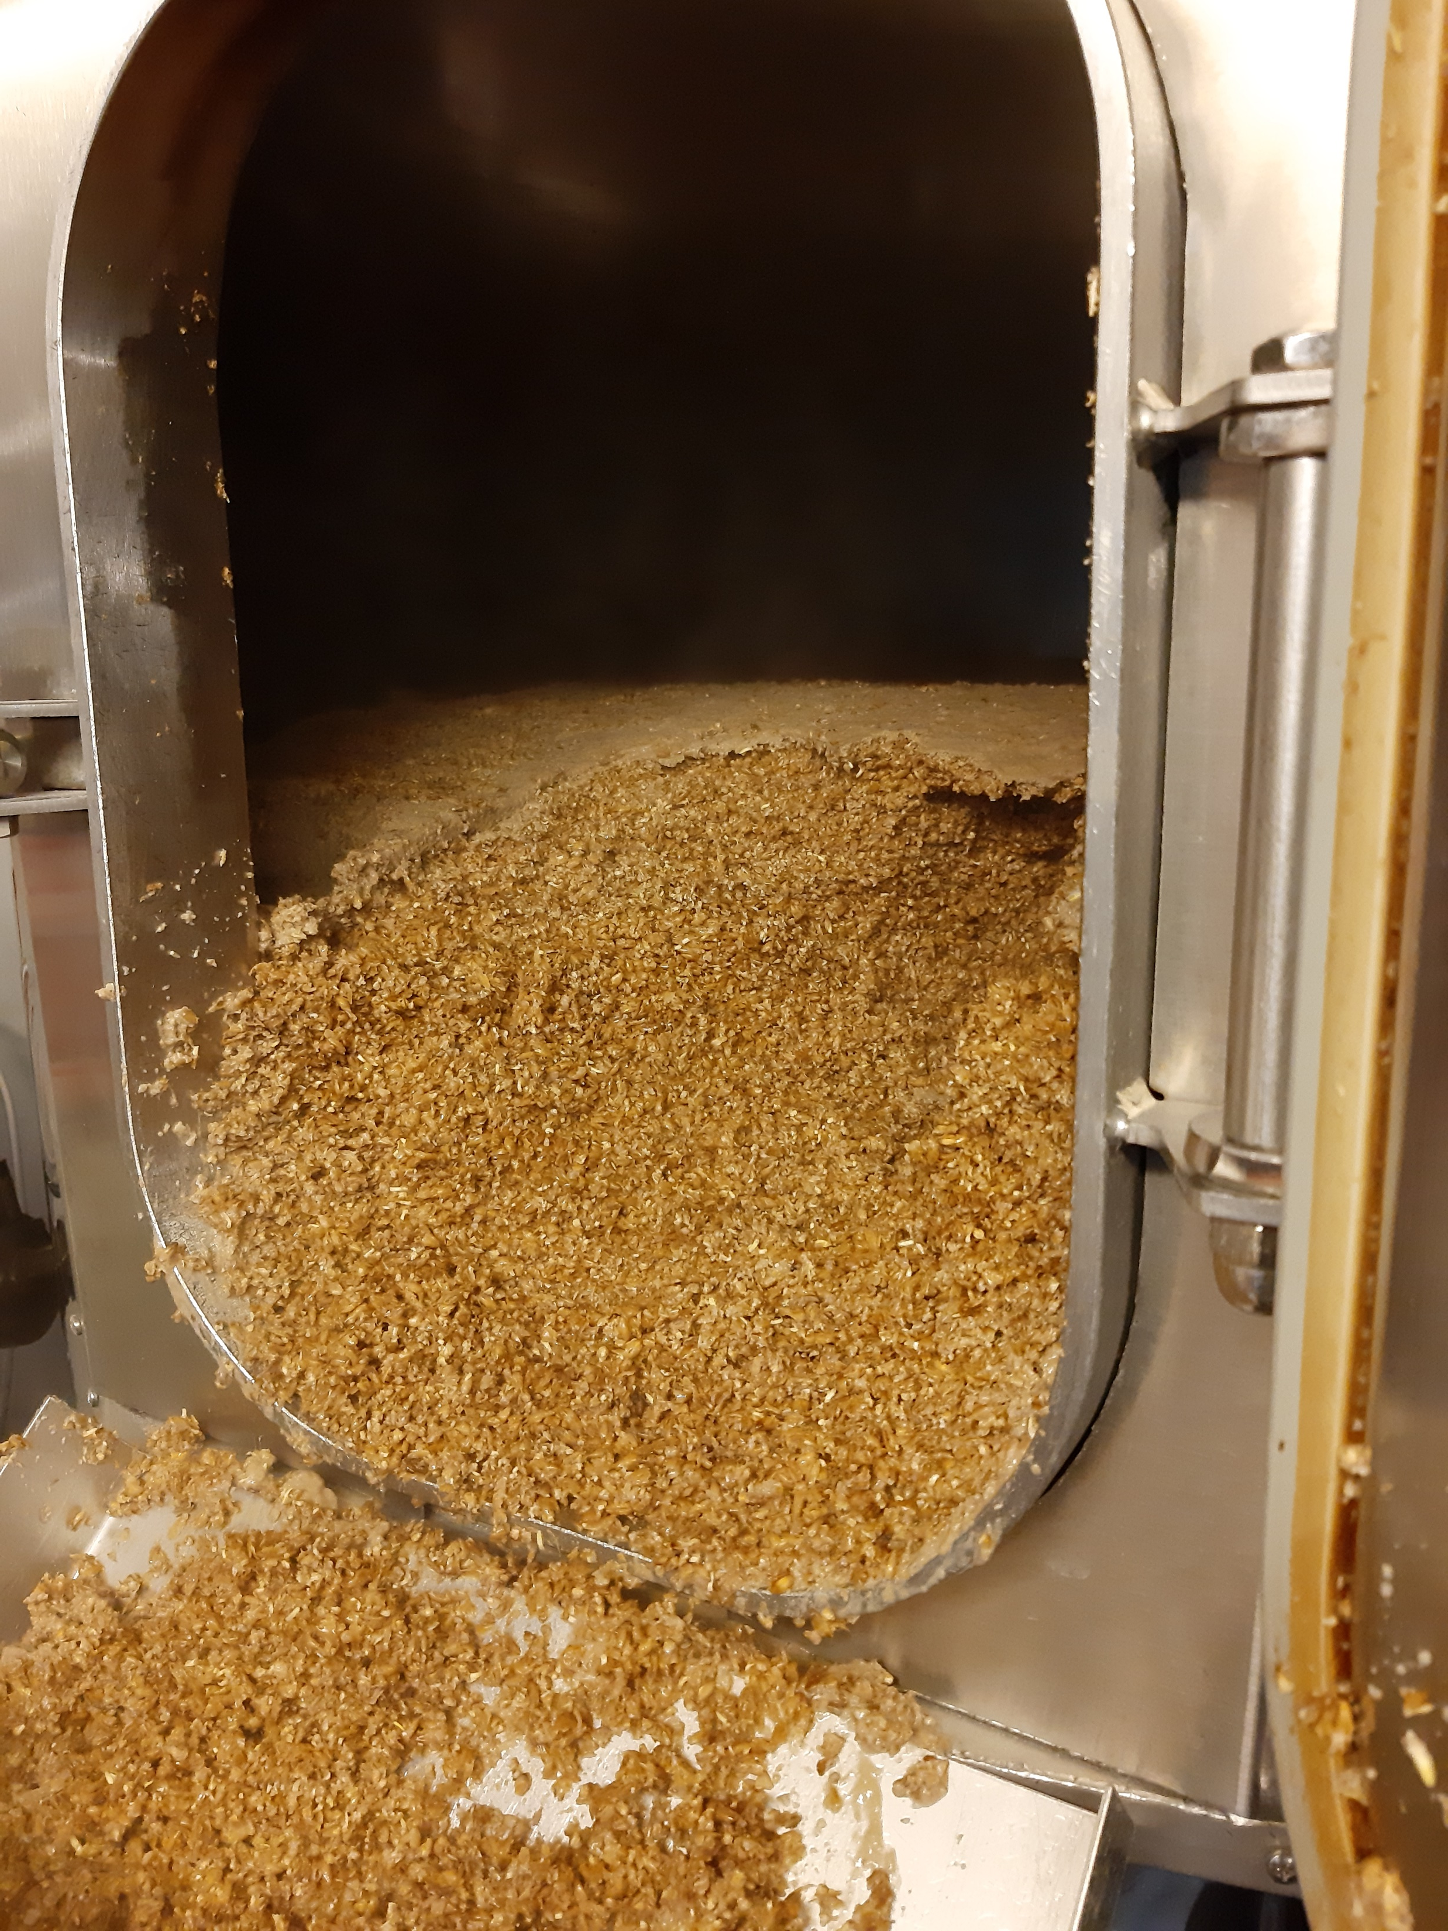
4) Brewer’s spent grain
Bread & granola
Animal feed

Slide 7
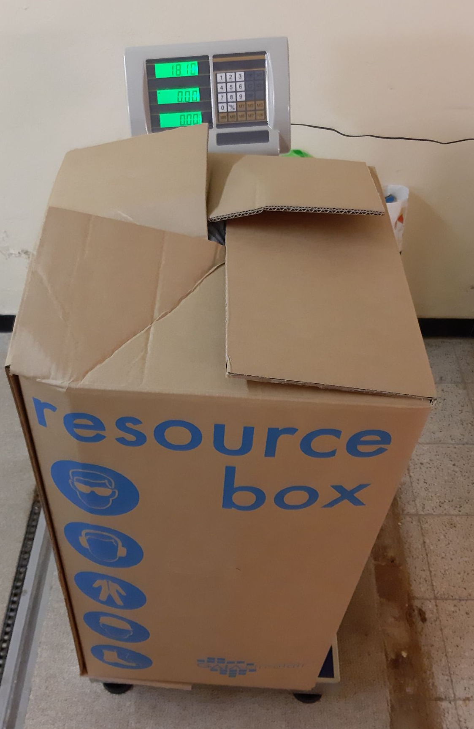
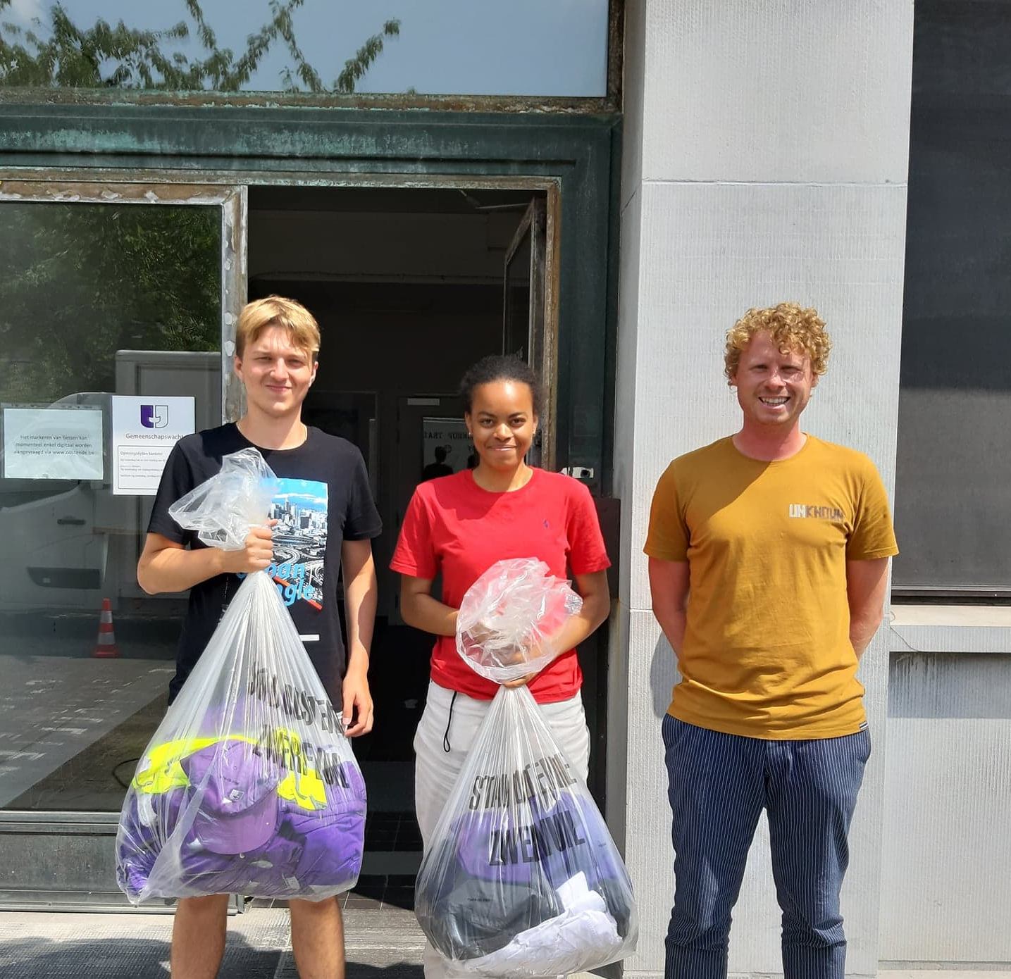
5) Company clothing
Logistical support
Obligatory recycling
New yarn &
car upholstery

Slide 8
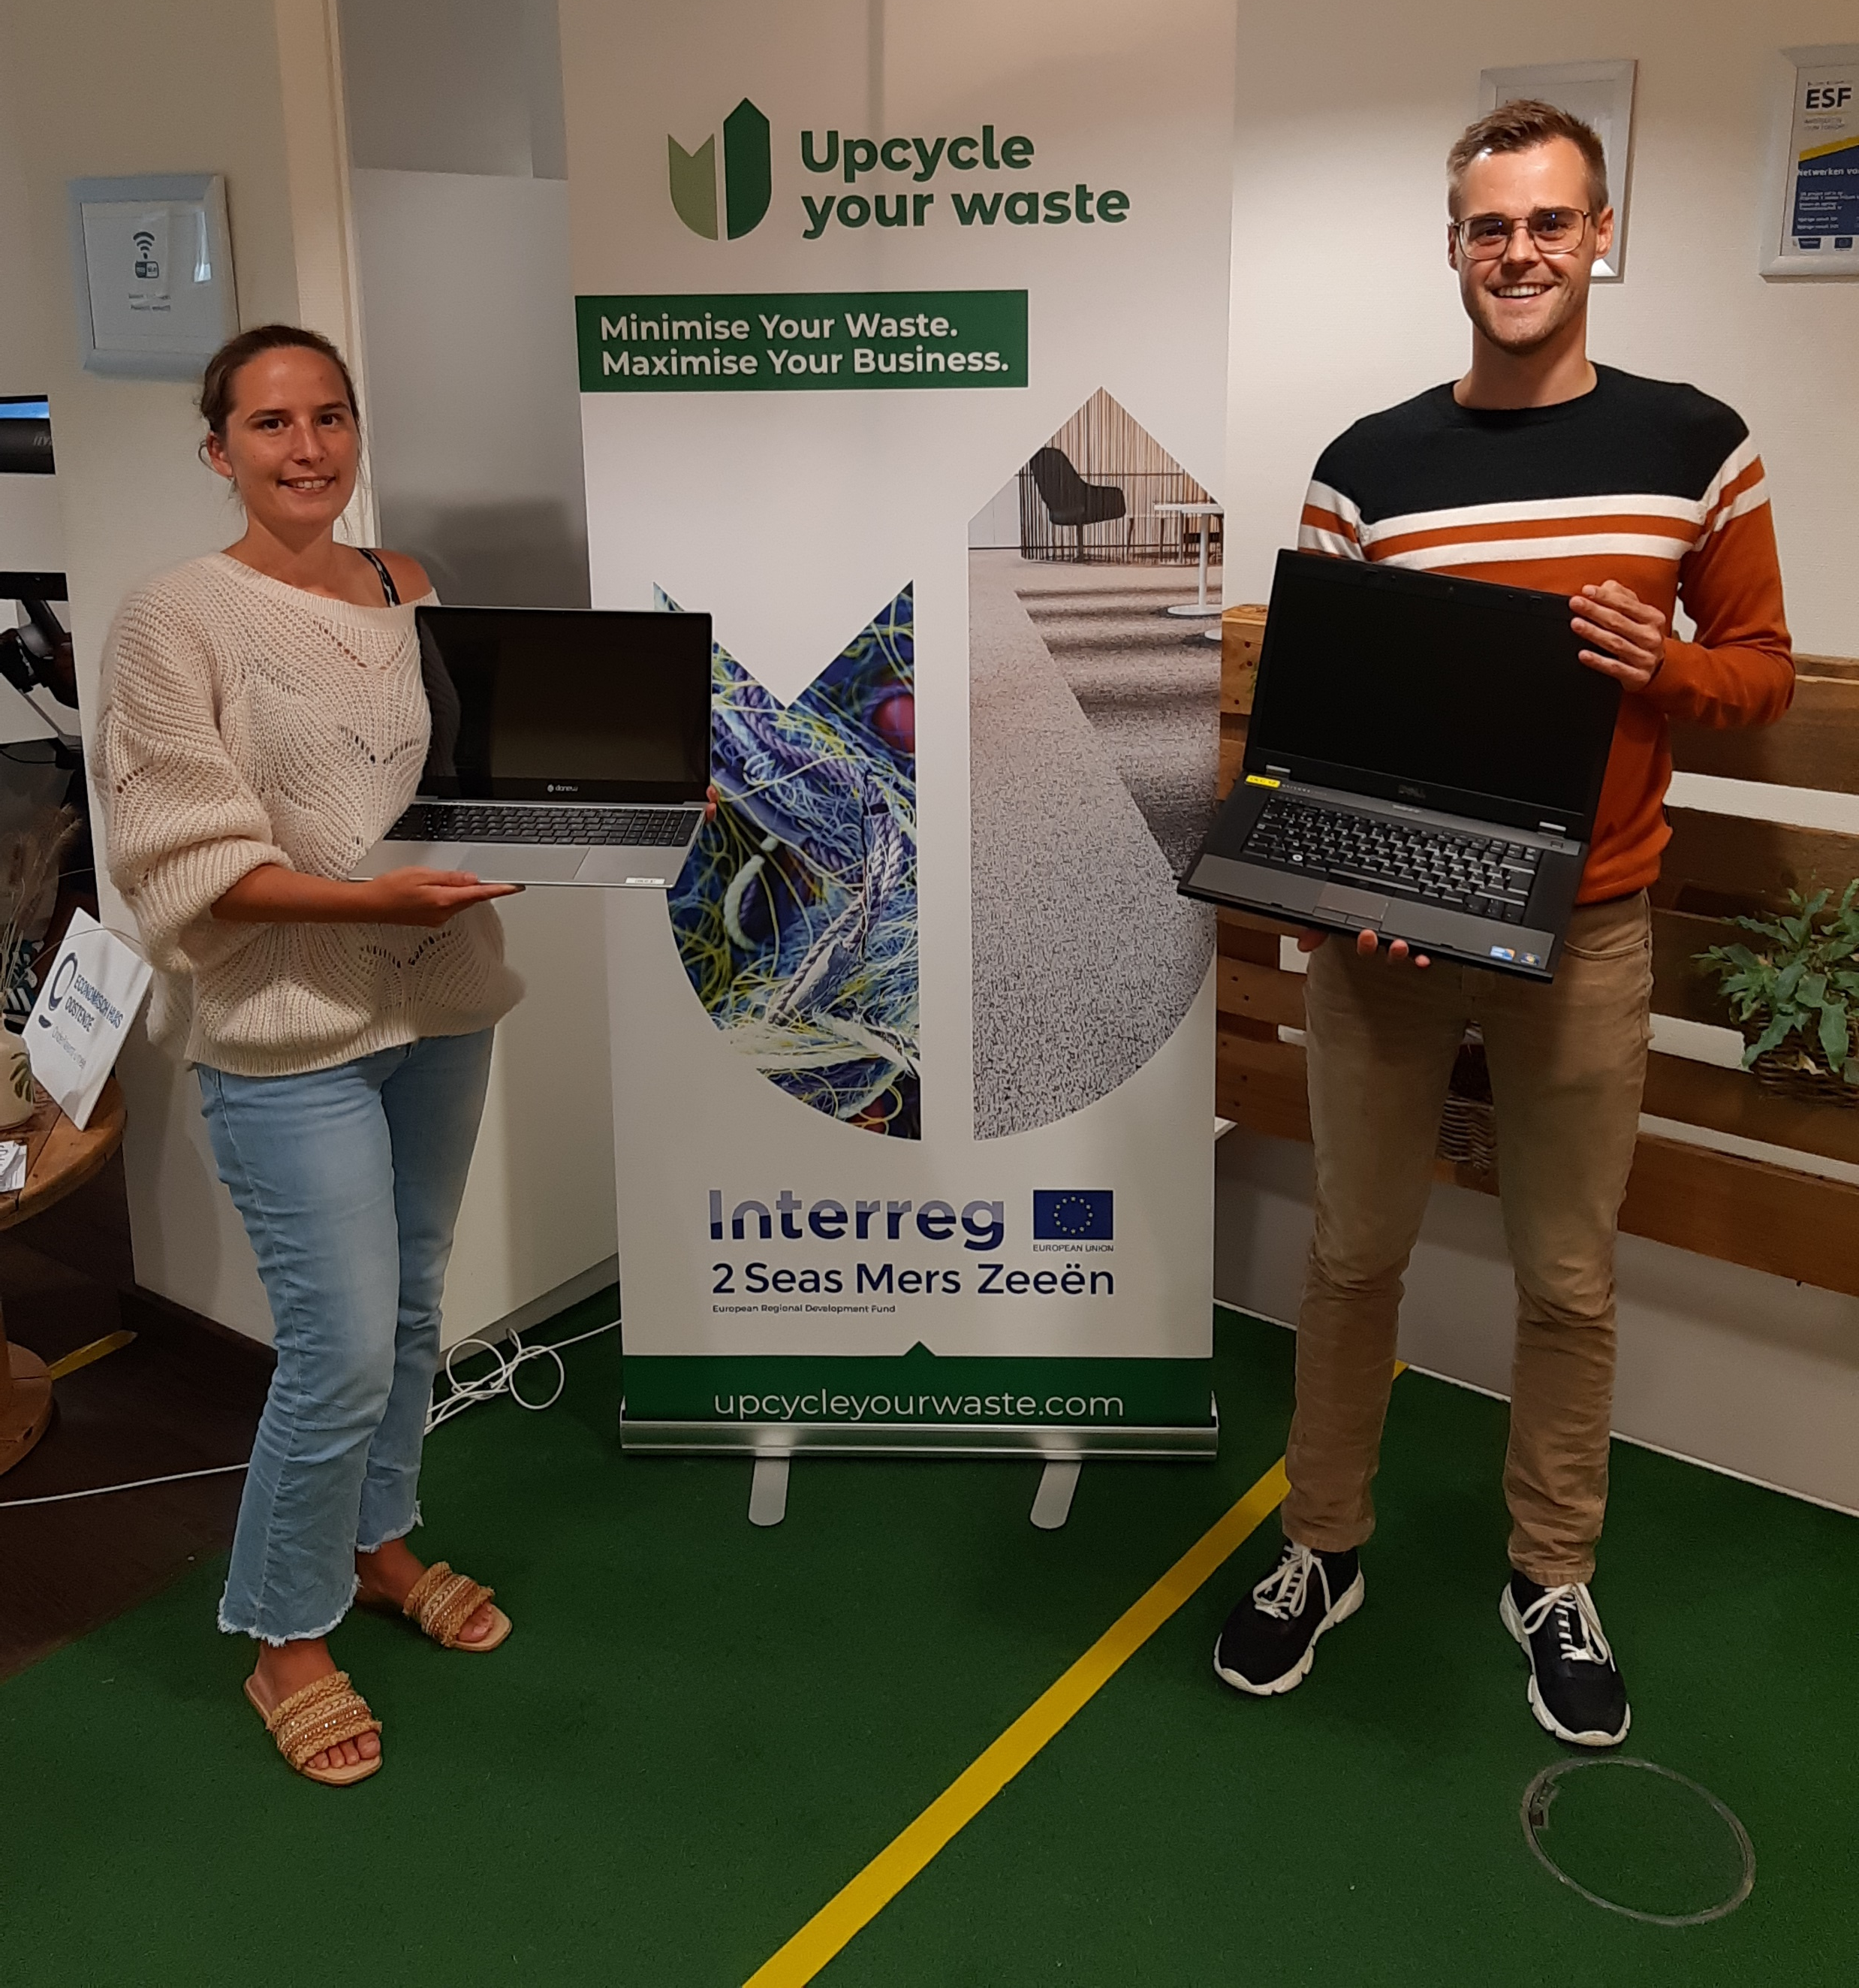
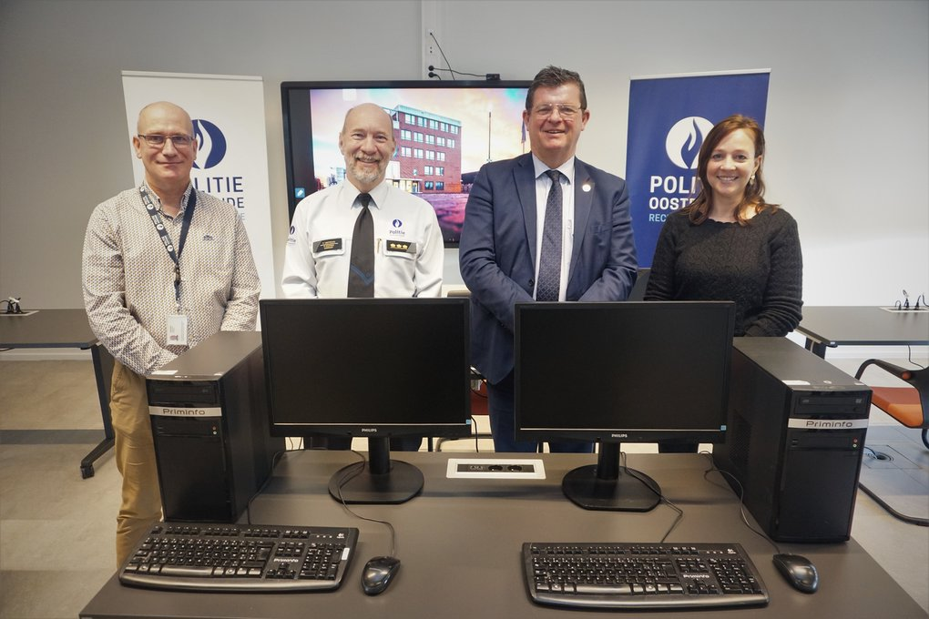
6) Electronic devices
43 personal computers
4 laptops

Slide 9
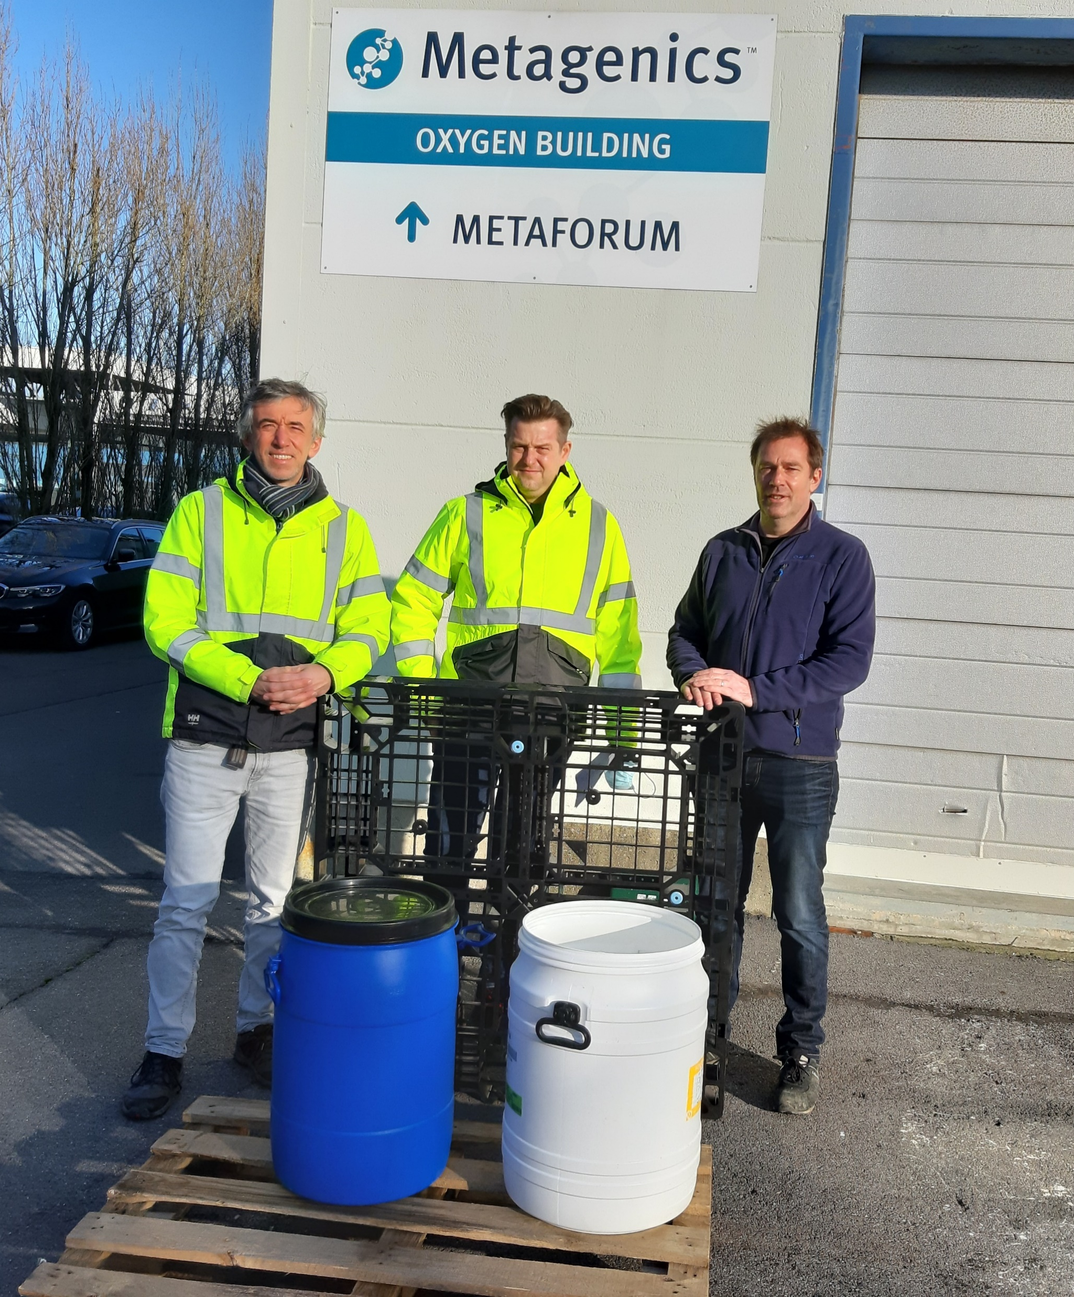
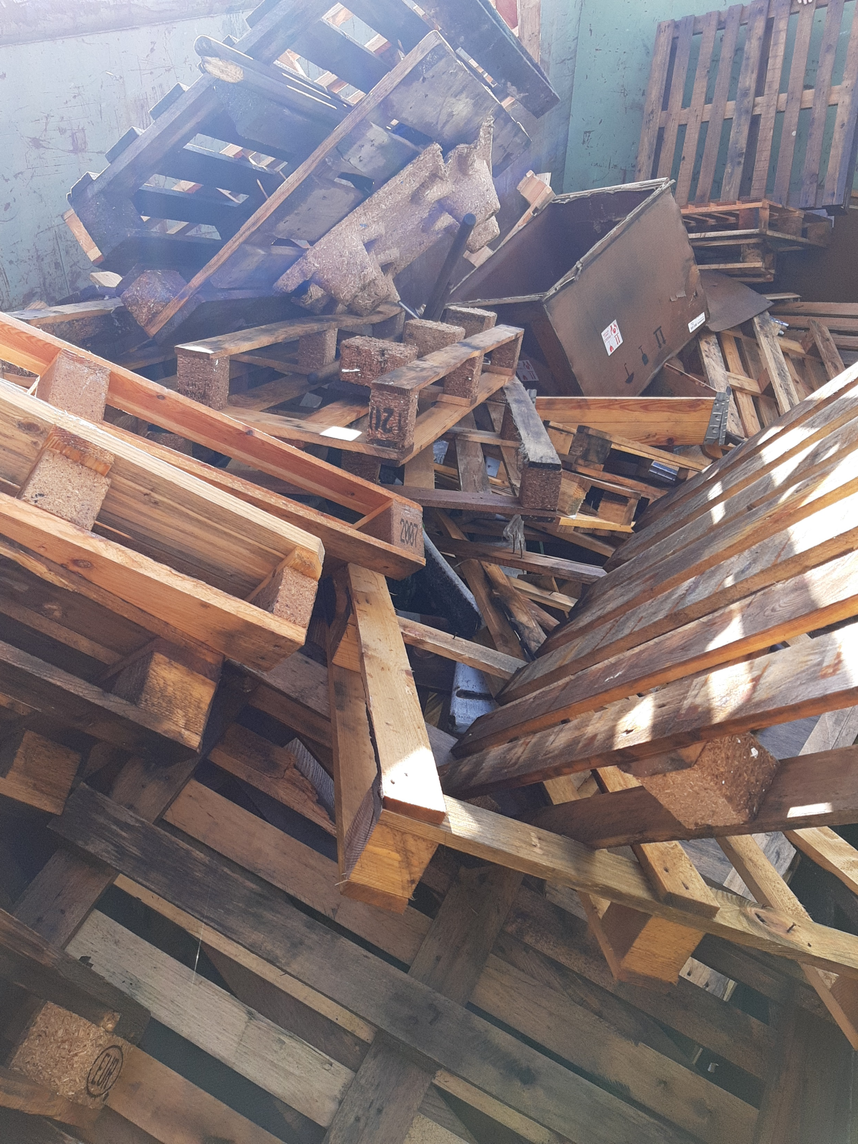
7) Pallets
Collection & Repairing
Pallets
Plastics

Slide 10
8) Hair Recycle
Patrick Janssen

Slide 11
Hair Recycle

Slide 12
dung dung is a non-profit organisation that collects hair and recycles it within the framework of the circular economy

Slide 13
In Belgium, between 800 and 1,000 tons of hair are collected each year in hairdressing salons. On average, hair accounts for 50% of a barber's trash. This bodily waste is now considered a resource.

Slide 14
Hair Recycle
Start in 2021
Nearly 600 member hair salons
Collection of bags in the fairs - development of our own logistics
Circular economy values
Addressing Oil Pollution Problems
Absorption with hair booms and hair mats
Capacity: 1kg of hair can absorb 8 liters of oil (lipophilic)

Slide 15
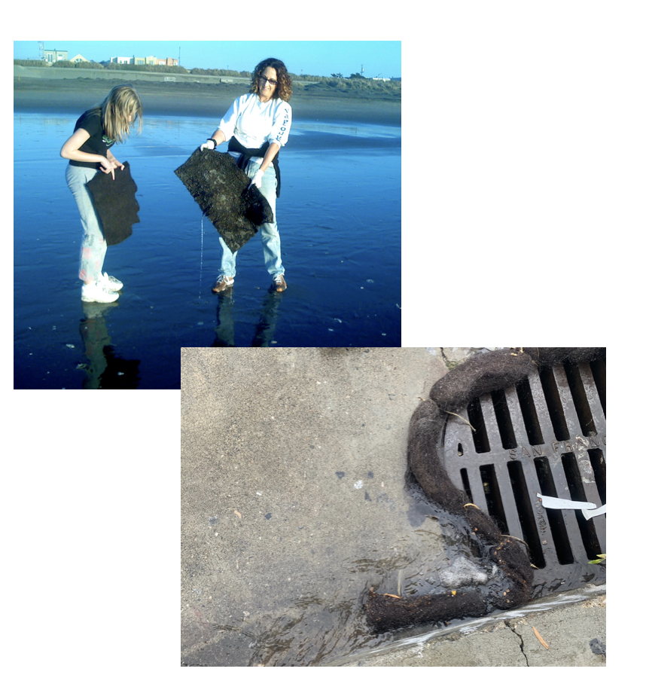
Matter Of Trust

Slide 16
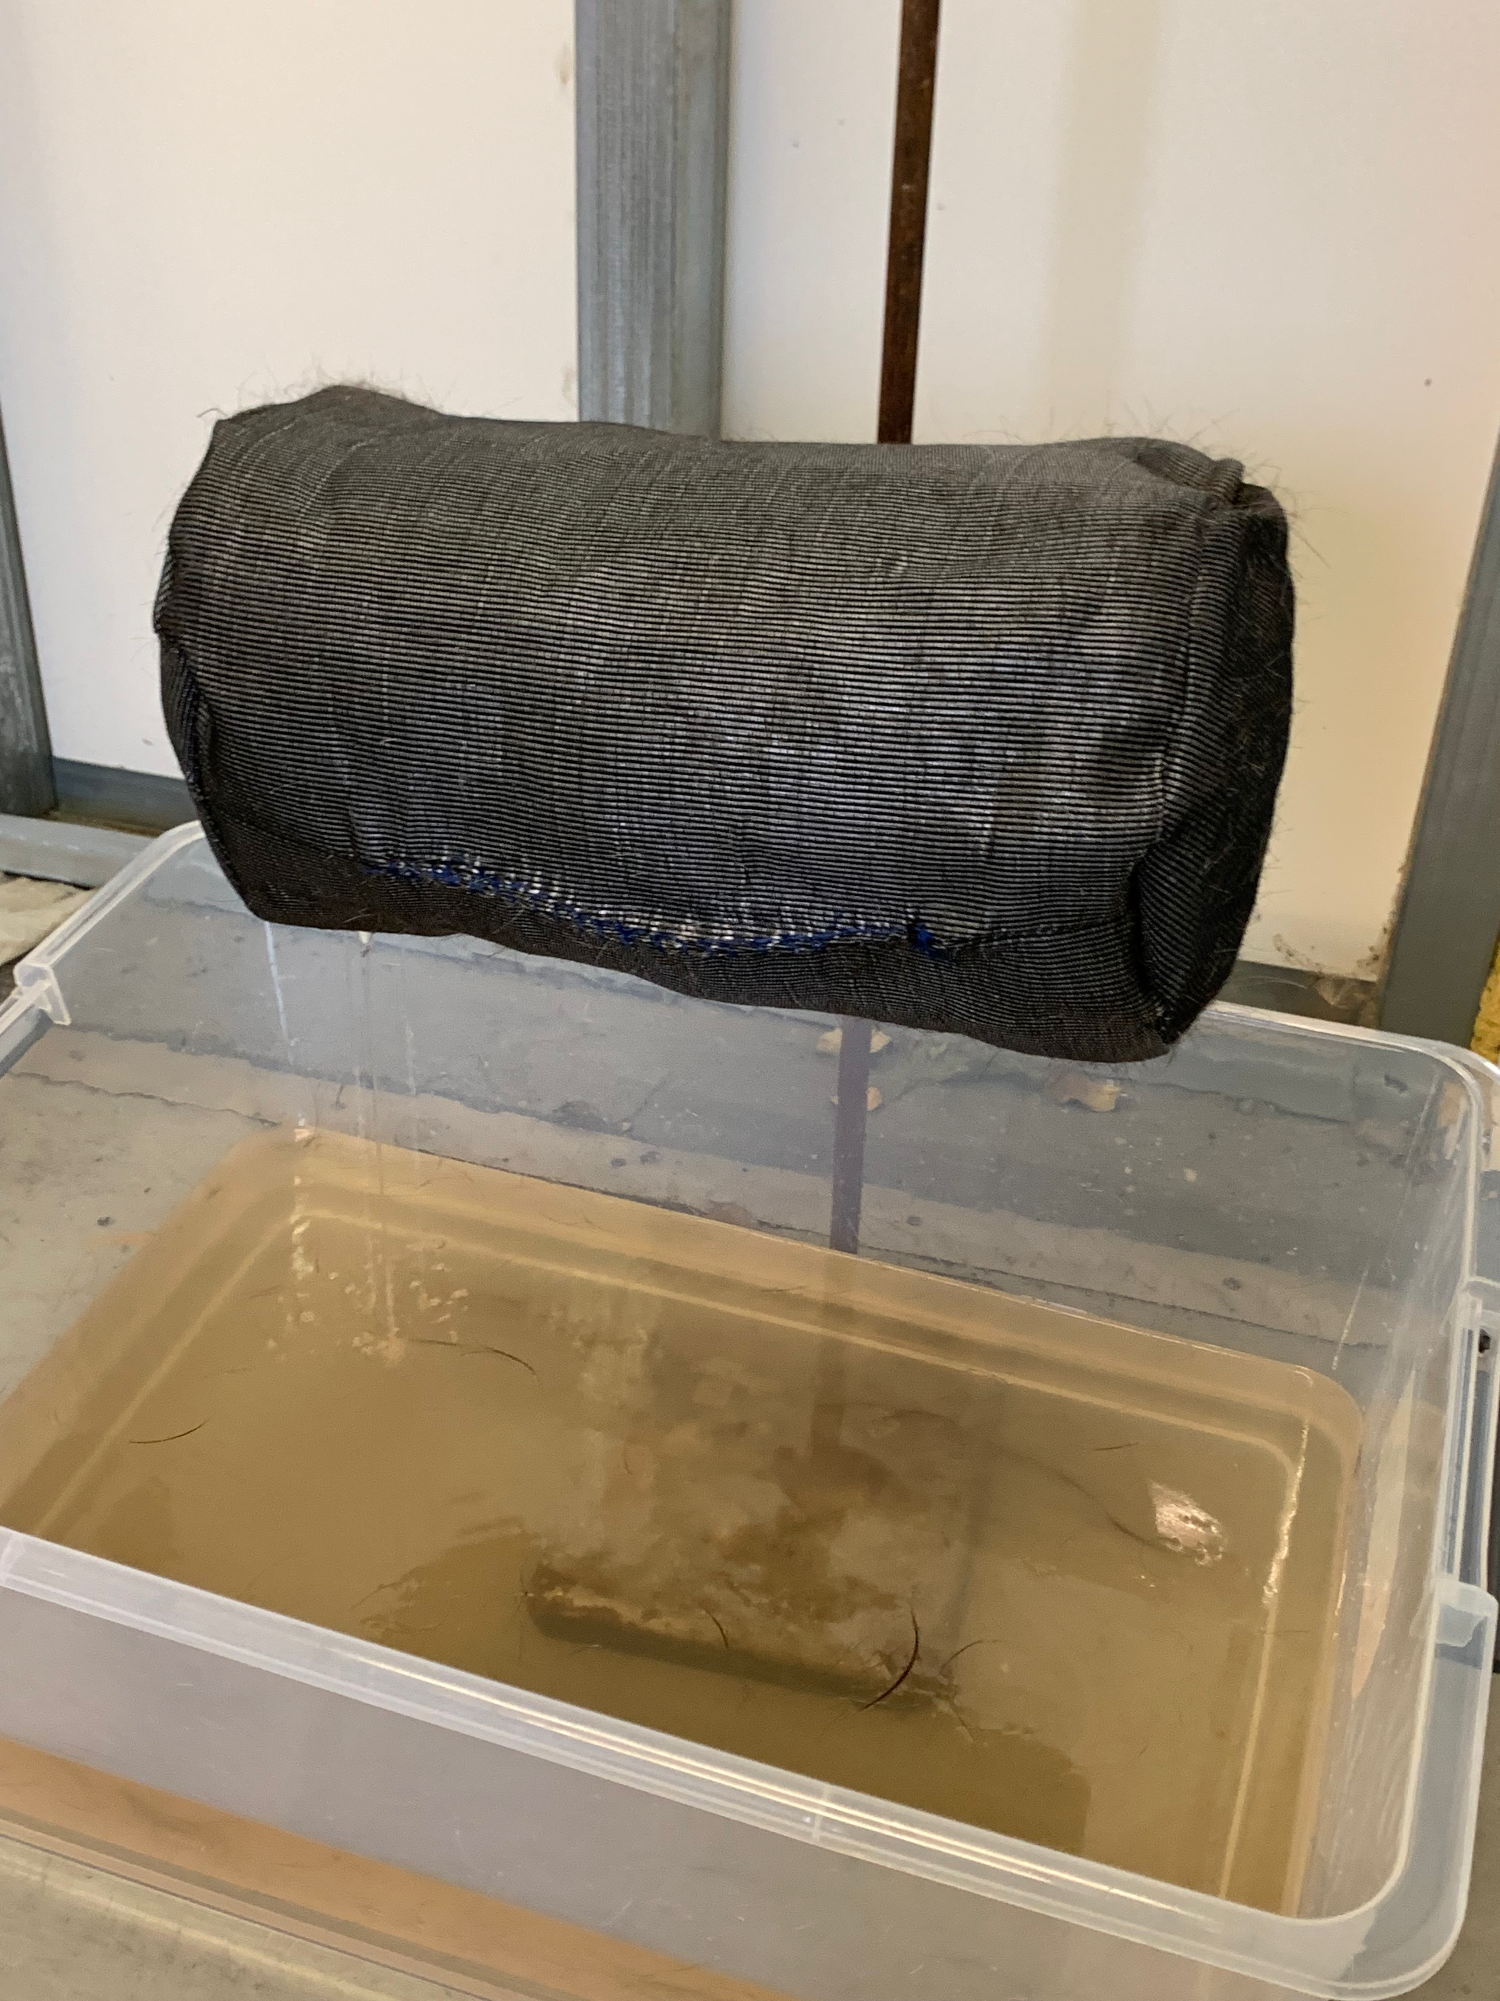
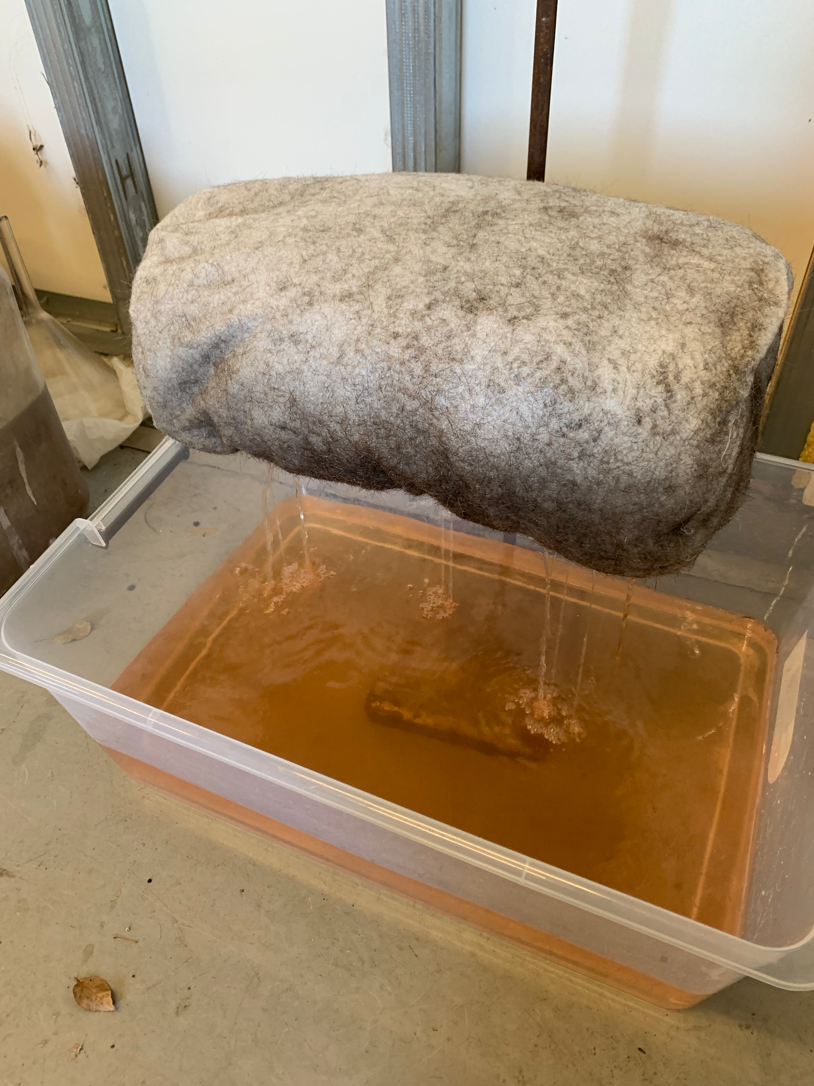
Celabor
Performance verification with a research center
Performance rated at 99% compared to traditional polypropylene socks

Slide 17
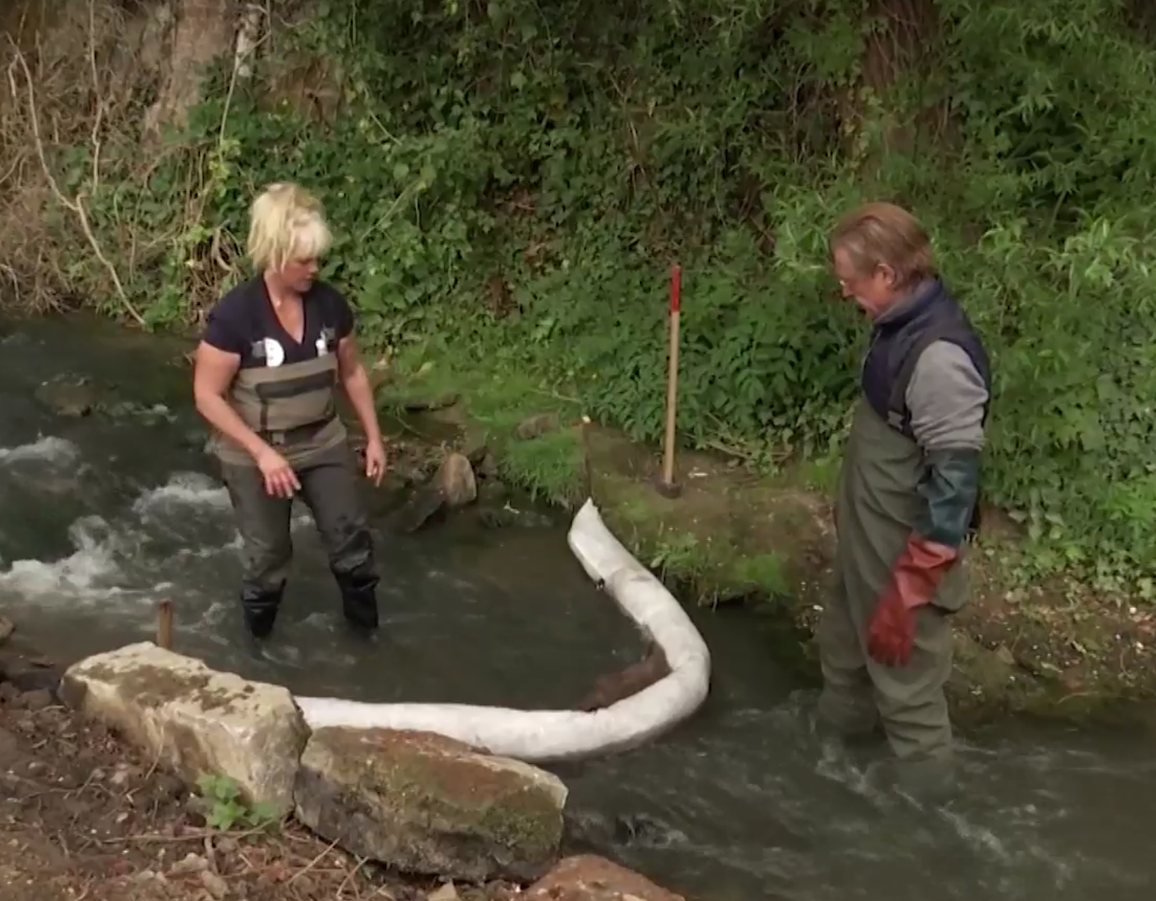
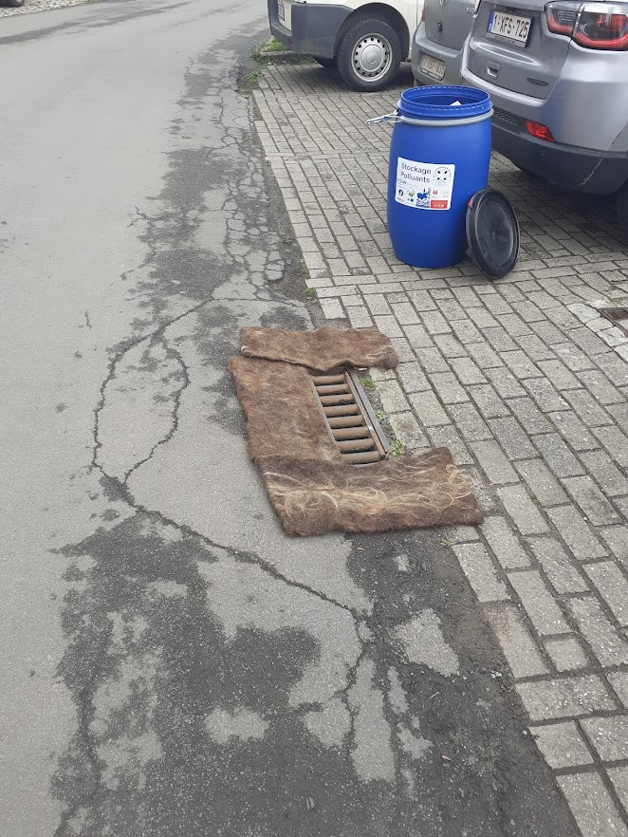
Recycled products
Collaboration with: les contrats de Rivière, Recycar, Infrabel, INBW, …

Slide 18
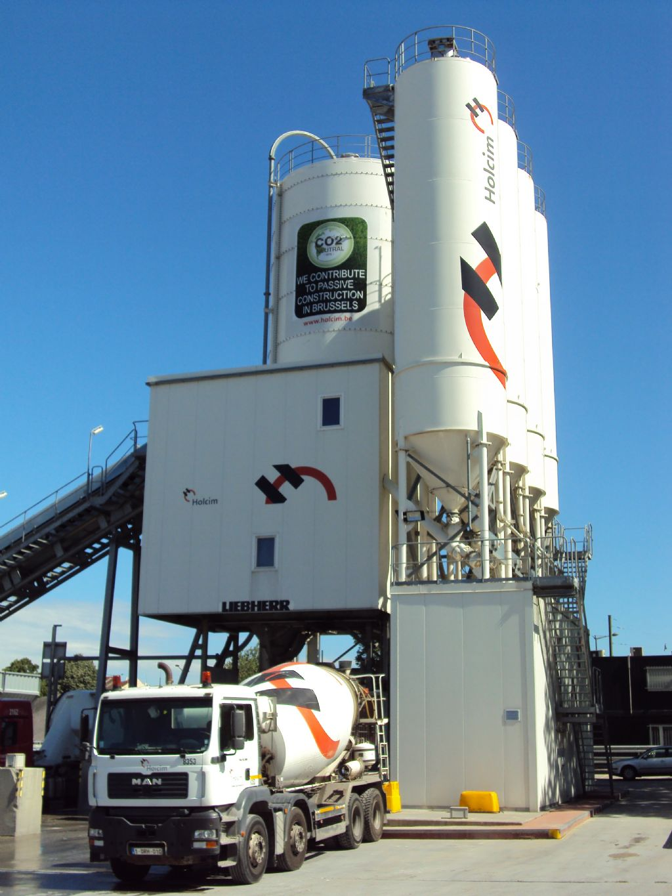
Holcim
Recycling of saturated absorbents in cement works.
Hydrocarbon used for its calorific properties. Hair used as concrete reinforcer.

Slide 19
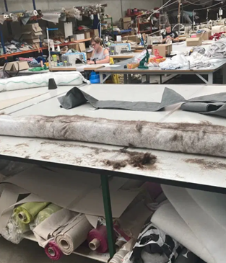
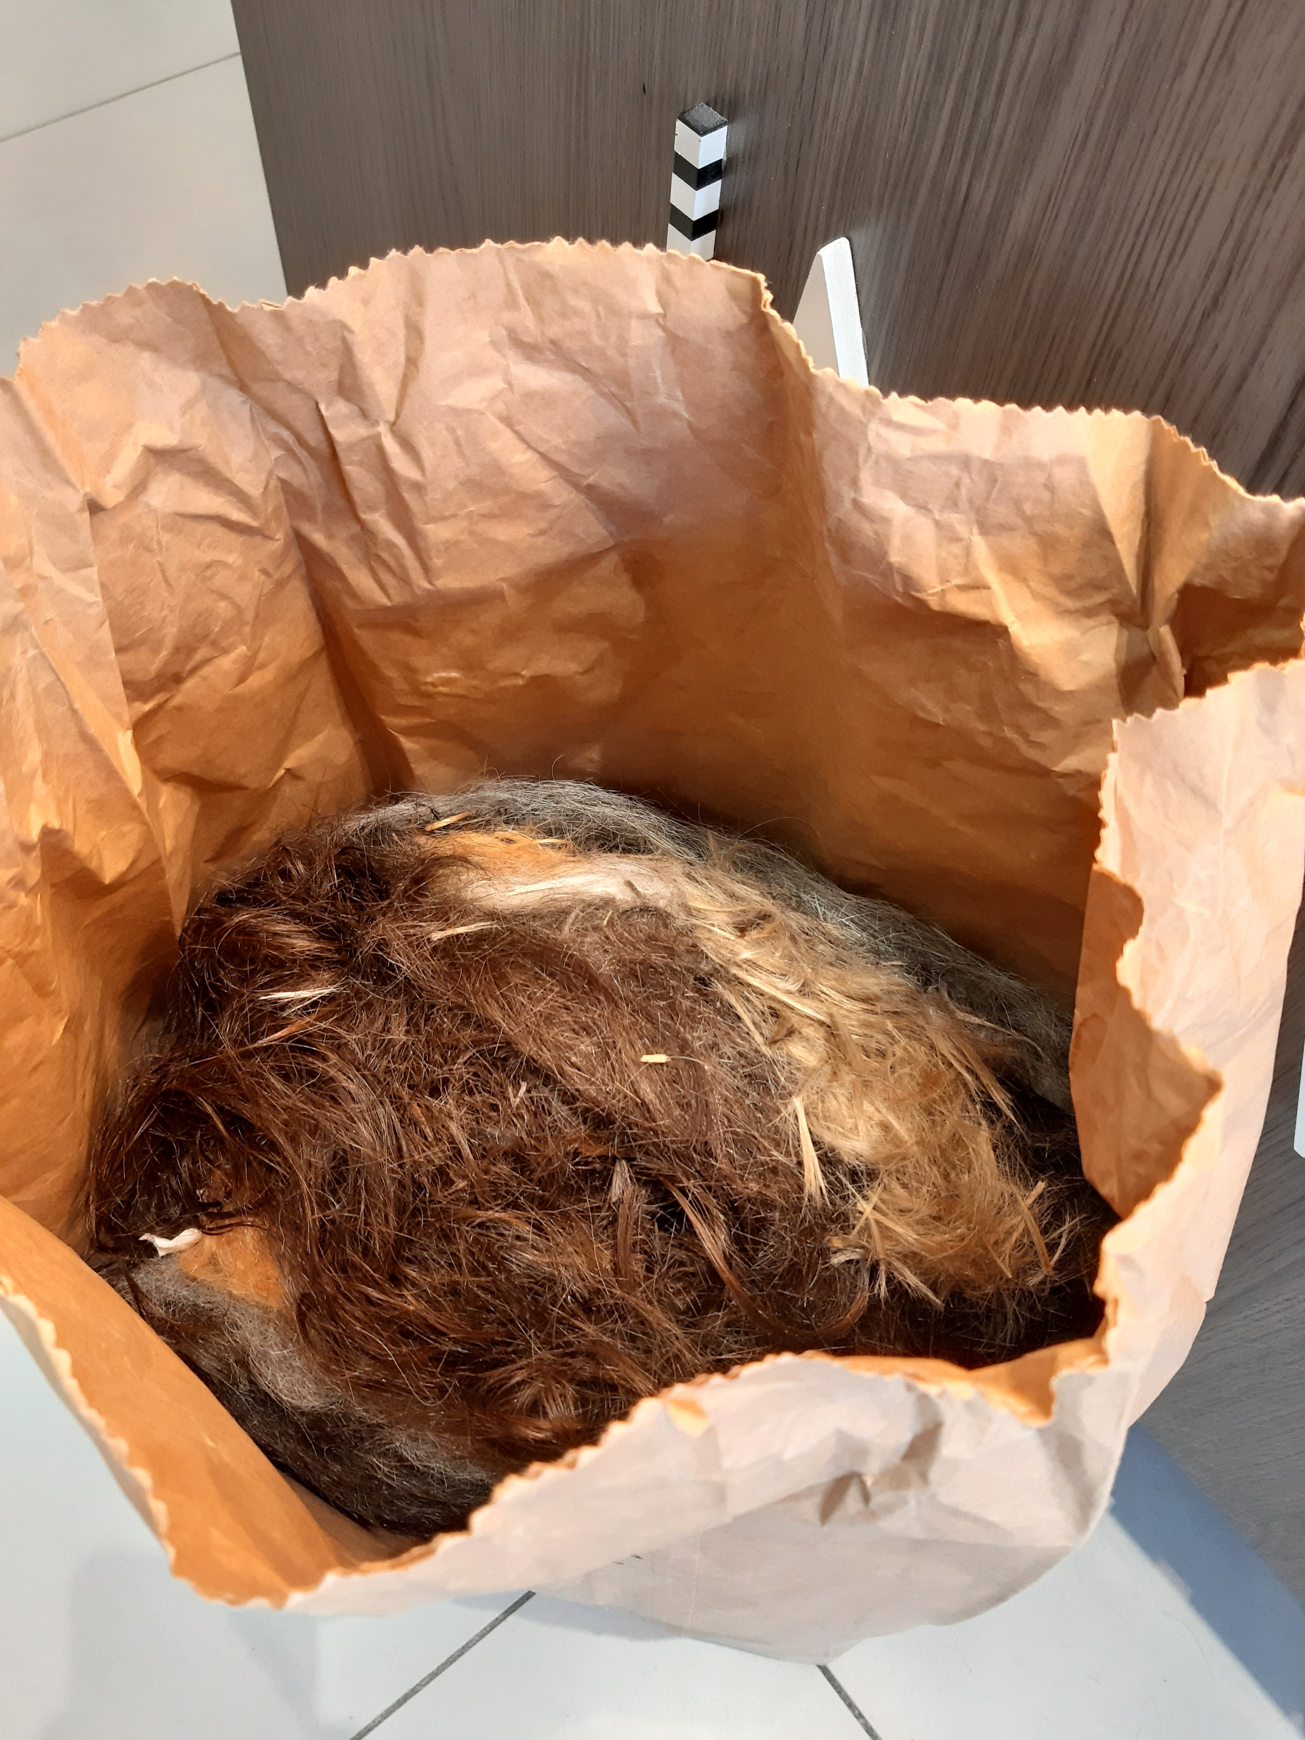
Partnership Economisch Huis Oostende
Raising awareness of hair recycling near hairdressing salons in Ostend. Already 5 partner salons.

Slide 20
Thank you for your attention !
Patrick Janssen

Slide 21
9) Diapers
Jeff Stubbe

Slide 22
together we make diaper recycling possible
INTRODUCTION TO WOOSH
Upcycling Achievement Conference // Thursday 17 November 2022

Slide 23
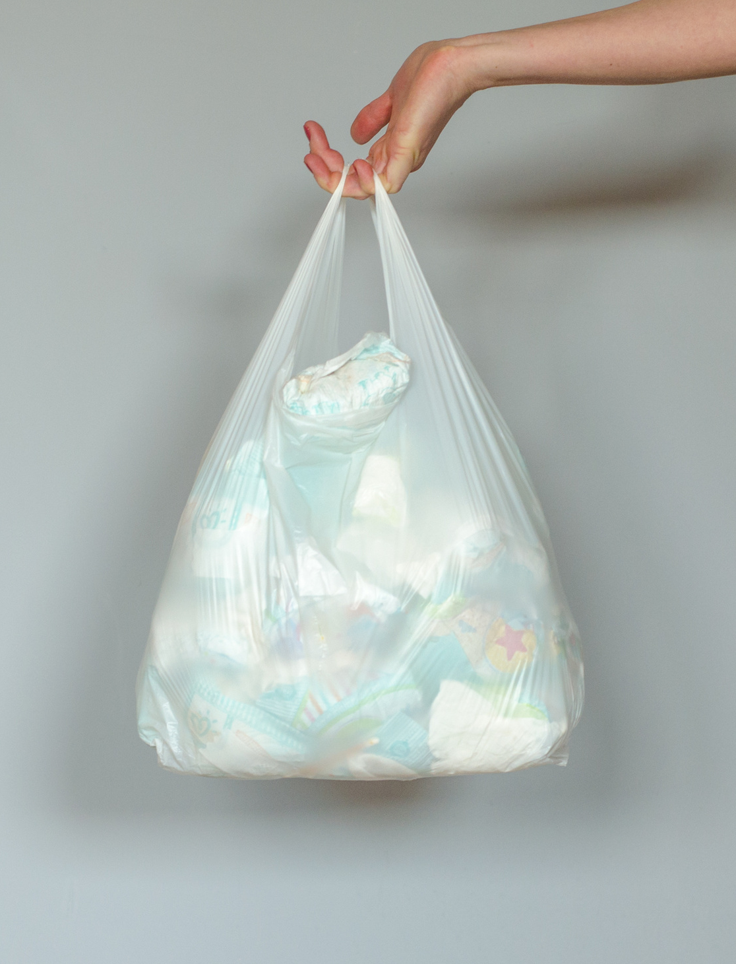
The challenge
+150.000 tonnes
of used diapers are produced in Belgium every year
The disposable diaper is one of the most successful single use consumer products of the 20th century. It is recognized by parents and caregivers worldwide as an essential part of everyday life.
This success has its downside however: today most used disposable diapers are incinerated or sent to landfill.
Diaper waste accounts for up to 8-12% of total residual waste
In its current state, the washable diaper is only accepted by 5% of the market (parents and daycares).
confidential

Slide 24
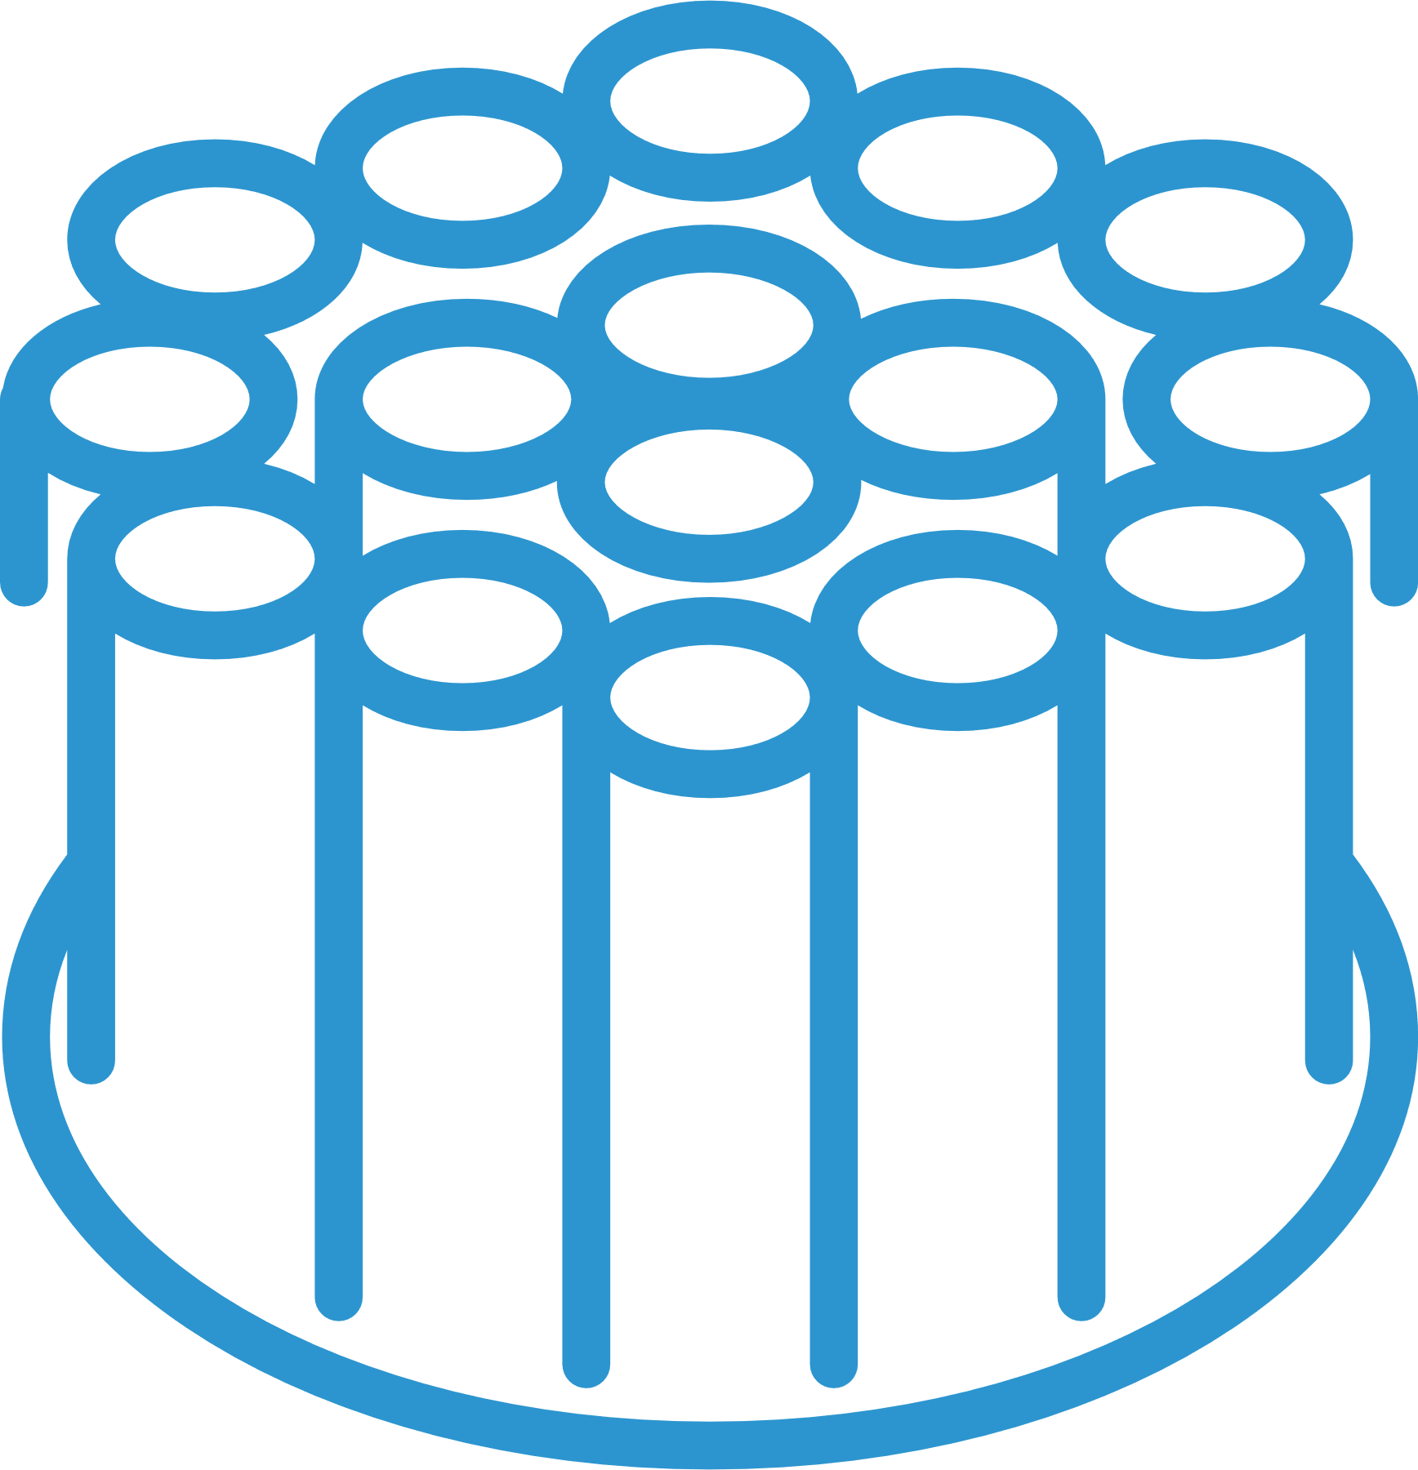
Used diapers
Diaper recycling
The process
The process of diaper recycling aims to efficiently separate and upgrade the separate materials of used diapers into new raw materials.
LCA studies show that diaper recycling can save up to 750 kg CO_{2 eq} per tonne of diaper waste processed vs the current practice of incineration with energy recuperation (in Flanders).
Several technologies have been developed over the past 30 years, often at high cost and with limited successful valorization. The outputs of the process varies depending on the technology.
Each technology requires a stream of diapers as an input (with as little contamination of other waste as possible). One of the biggest challenges is the logistics and cost to access a ‘pure’ waste stream of used diapers.
biogas
compost
plastic
cellulose
SAP
confidential

Slide 25
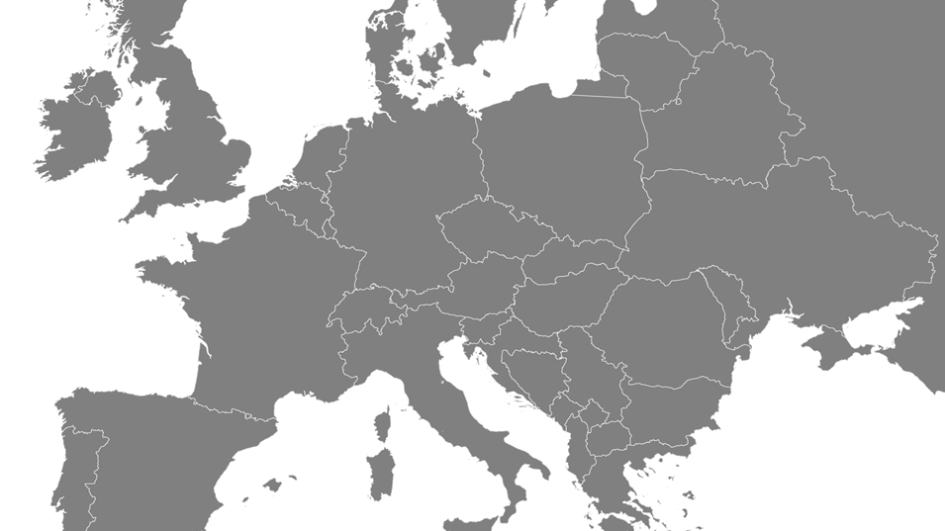
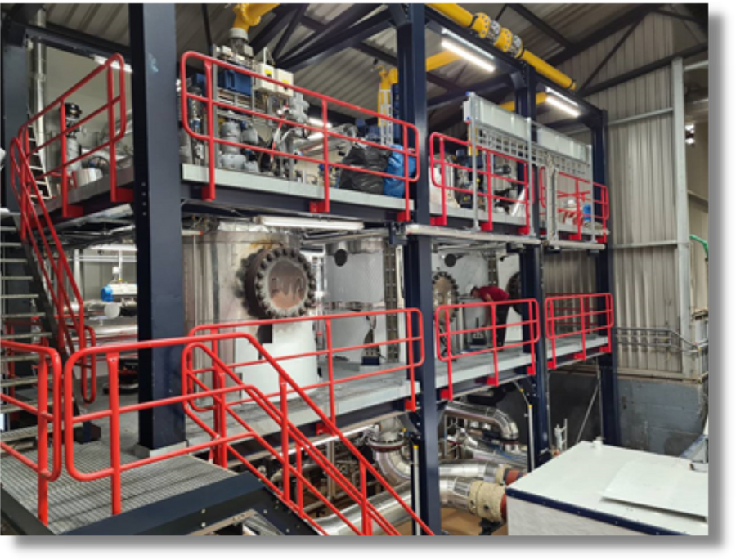
Diaper recycling
Installations in Europe
ARN – Elsinga technology
Location: South Wales, UK
Collection: Natural UK
Capacity: 8.000 tonnes
Location: Nijmegen, NL
Collection: municipalities
Capacity: 15.000 tonnes
Location: Treviso, IT
Collection: Various sources
Capacity: 10.000 tonnes

Slide 26
together we make diaper recycling possible

Slide 27
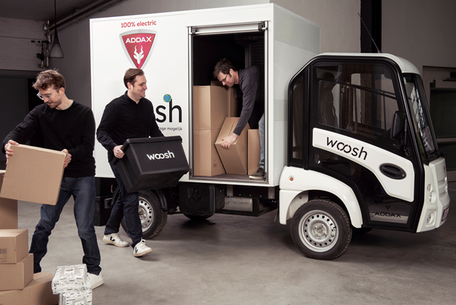
What is Woosh?
Woosh provides a worry-free diaper service to our customers. We deliver new diapers and collect used diapers at the same time using reverse logistics.
We can deliver a ‘pure’ stream of used diapers to recycling plants which enables our mission to make diaper recycling possible.
Furthermore, our service gives us access to the entire value chain to enable more sustainable solutions in the future.
confidential

Slide 28
Initial focus on a defined market segment
In a first phase, child daycares and nurseries are the focus as these are most efficient to serve.
Woosh has a phased plan to open other market segments in the future.
confidential

Slide 29
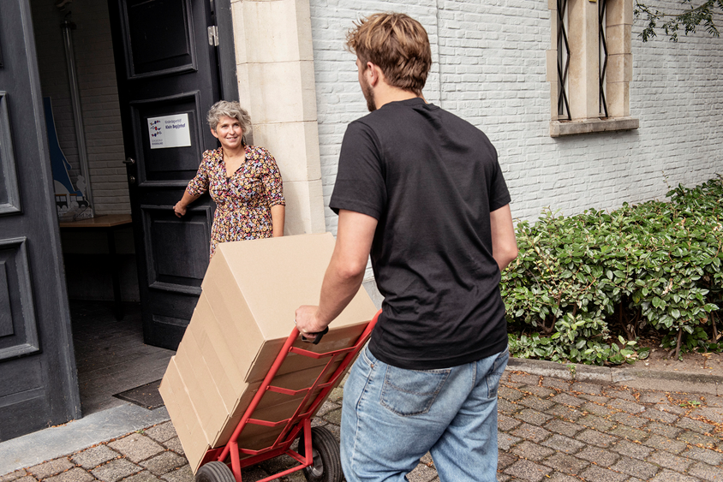
New diapers
Woosh model
daycare
Used diapers
1. A worry-free service for busy child daycares
Daycares subscribe to Woosh and order diapers on a user-friendly ordering platform every week.
Woosh delivers the new diapers on a fixed weekly delivery day. We bring the new diapers to exactly where they’re needed.
At the same time, Woosh takes away containers full of used diapers.
confidential

Slide 30
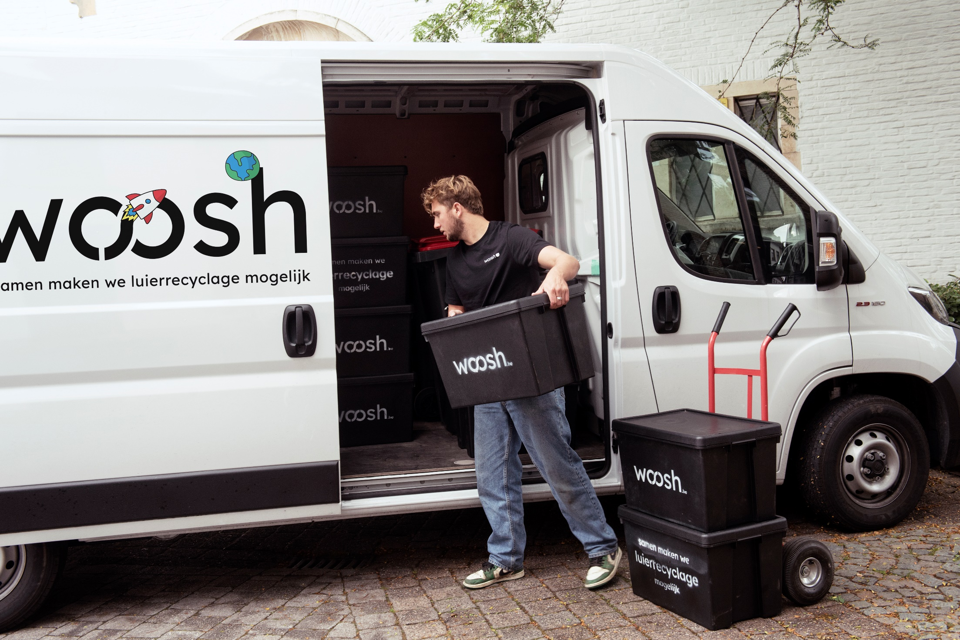
New diapers
Woosh model
daycare
Used diapers
2. Integrated logistics
Woosh takes care of all logistics around diapers for daycares and child minders.
We use a system of reverse logistics where products we deliver and containers we collect are transported in the same vehicle.
Woosh always drives with a full van. This reduces traffic in busy urban areas, reduces driven km (and CO₂) and is very efficient!
confidential

Slide 31
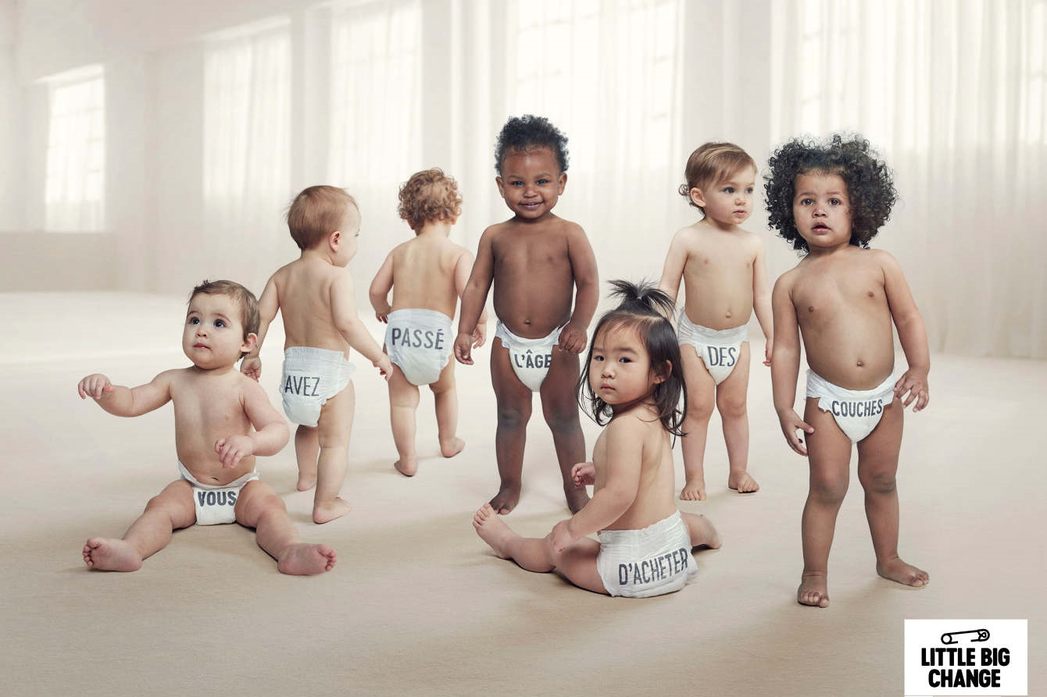
New diapers
Woosh model
daycare
Used diapers
3. An eco-friendly diaper
The current Little Big Change diaper from Ontex is a great fit for Woosh: a high-quality diaper with eco-friendly features:
Recyclable
12 hour protection
Hypoallergenic and dermatologically tested
Climate neutral impact
Free from natural latex, lotions and perfumes
confidential

Slide 32
Impact throughout the entire chain
A unique position through a strong focus on service and resolute commitment to reverse logistics gives Woosh access to the entire diaper chain.
Our aim is to close the loop completely by forging strong partnerships in 3 key domains:
PRODUCT: In the partnership with diaper producer Ontex, we are committed to design for recyclability. By keeping the recycling process in mind when designing new diapers, we can design products for more efficient recycling and higher output. This gives us a competitive advantage.
SERVICE: Our partnerships with major logistics companies in Belgium give us the ability to scale to the whole country (and beyond). No matter where your daycare is, Woosh can service you.
RECYCLING: Woosh is a key partner in investment files to obtain subsidies via Recycling Hub Flanders (Flemish Government) for the installation of the first recycling installation in Belgium. The Flemish Government intends to ensure diaper recycling by 2025.
PRODUCT
RECYCLING
SERVICE
Focusing on product, service and end-of-life gives us a unique competitive advantage that translates into strong commercial positioning and a major sustainability impact.
confidential

Slide 33
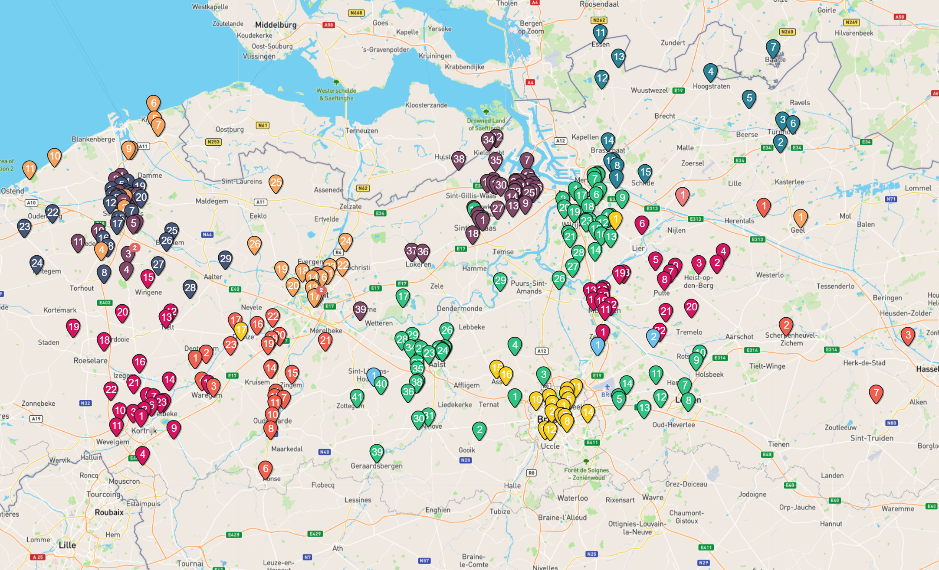
Woosh today
325 daycares representing over 7.700 children are signed up to the Woosh service across Flanders and Brussels. This represents more than 8,000,000 diapers per year.
New daycares are being added every week. Woosh will soon be operating from 5 hubs across the country in order to serve our customers as efficiently as possible.
The Woosh team has grown from 3 FTE at launch in April 2021 to 10 FTE today, not including our logistics partners and delivery drivers.
Woosh is closely involved in conducting feasibility studies and technology reviews for the placement of diaper recycling plants in Flanders to make diaper recycling possible.
confidential

Slide 34
Woosh tomorrow
Woosh is scaling to 1,000 daycares or 25,000 child places in Belgium over the next 12-16 months.
In selected regions in Q3 2022 we are rolling out Woosh at home, our first B2C service.
The first steps to extend the Woosh model to other sectors are being investigated.
Development of a circular product portfolio including a diaper designed for recycling and making optimal use of our unique logistics model.
Woosh has international ambitions.
confidential

Slide 35
together we make diaper recycling possible

Slide 36
What’s next?
Research
Shrimp peels / chitosan (Vives)
Mussel shells (VLIZ & coastal cities )
Bitumen roofing (Derbigum)
Coffee ground as a fertilizer (Group DC)
Water reuse
Sustainable energy (solar panels / wind energy)
Leverage future research and collaboration with businesses

Slide 37
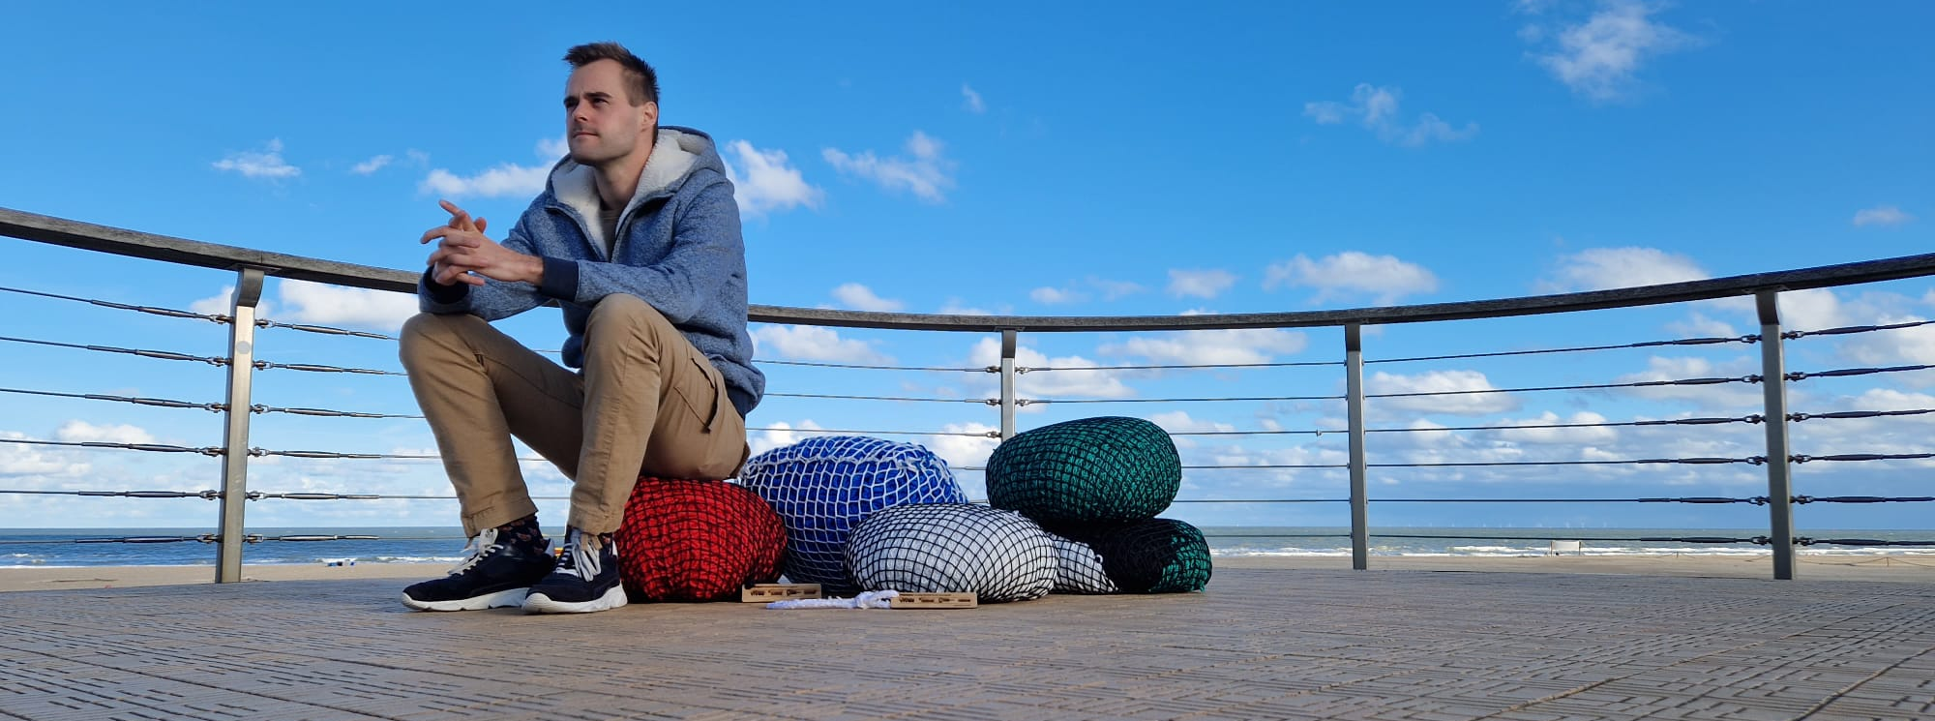
Thank you!
Questions?
Mail: arne.rossel@economischhuis.be
Website: www.upcycleyourwaste.be

