Slide 1
Ecopal : From the development of the ZI to a greener industry
Karine Dufay
11 Février 2021

Slide 2
Ecopal
Flandre-Dunkerque
ZI des Synthes
The experimentation
Accompaniment today
Examples of waste grouping – papers / archives
In 2020

Slide 3
Ecopal ?
Association 1901, non-profit making
Created in 2001 by and for companies 1 team accompanied by directors from the economic world More than 100 members (SMEs, PMI, Industries, TPE, public administrations, universities, etc.) Objective
Developing industrial ecology Facilitate business-to-business flow exchanges (grouping, substitution)

Slide 4
Ecopal ?
Strategy :
Accompanying businesses (Environment), Grouping flows with the aim of creating/maintaining local activities, Train: more than 133 people (trainees/employees) - network actors (students, employees, local authorities),
Contribute to the strategic direction of the partners.

Slide 5
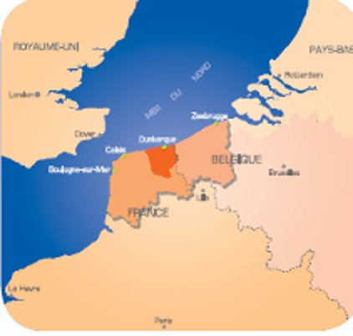
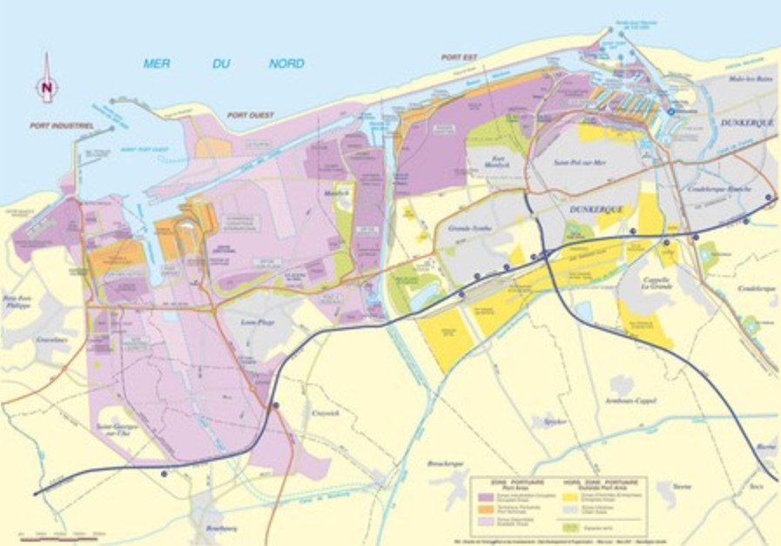
Flandre- Dunkerque
The territory - 1 favorable industrial area
260,000 Inhabitants 6,000 companies
14 SEVESO sites 7,000 hectares of industrial land
45 Industrial Zones 1st European Energy Platform
3rd French Port 1st French freight yard
(12% of national freight)
Notes:
1ère Plateforme énergétique européenne = 1er centre nucléaire européen (graveline) + Terminal méthanier + DK6 (1ère centrale à cycle combiné gaz de France + le plus grand réseau français de chauffage urbain+ Dépôts pétroliers + 1er port charbonnier français

Slide 6
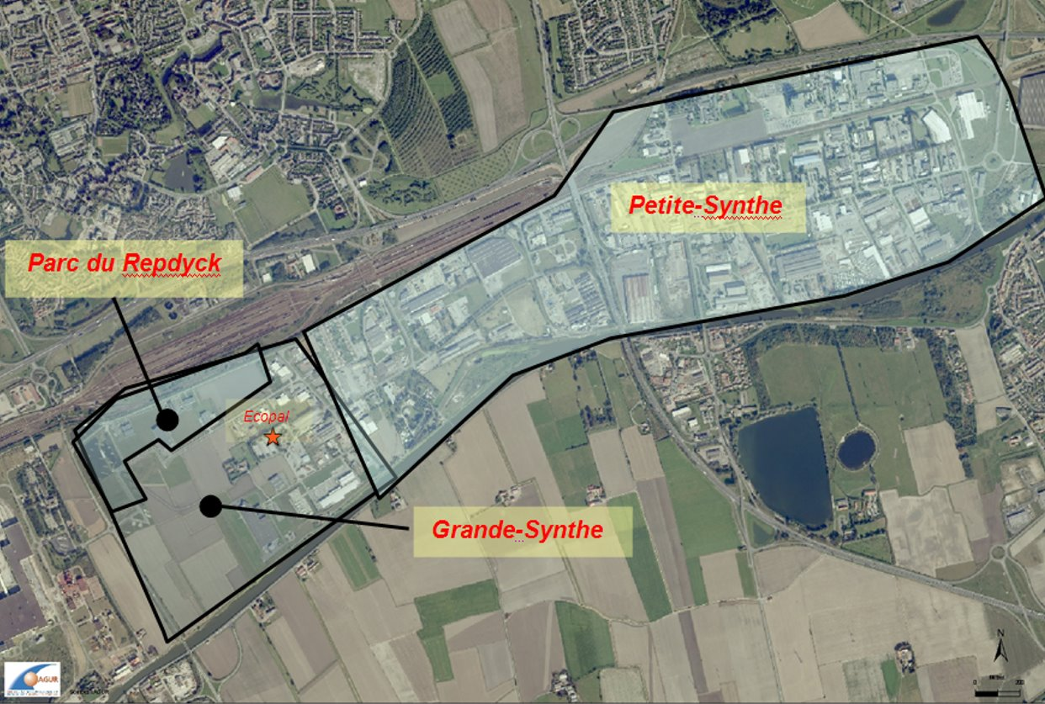
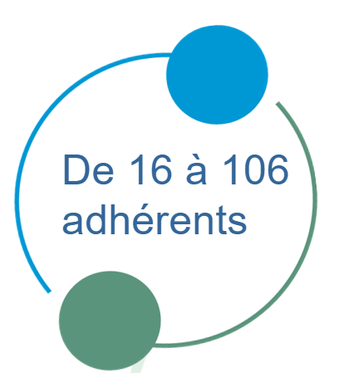
ZI des synthes
2002/2007: ZI animation by Petite-Synthe - Grande-Synthe
160 companies - 6,000 employees - Business sectors: metallurgy, chemistry, plastics, metal coating, agri-food, business services
Goal: Meeting business expectations, becoming a trusted third party

Slide 7
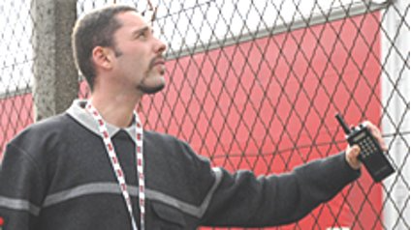
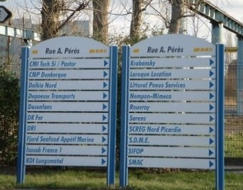
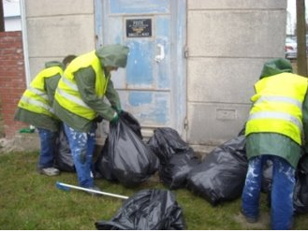
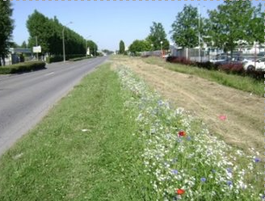
The experimentation
The accompaniment :
2002
Ecopal caters to the needs of SMEs/PMIs, TPE
Grouping of security needs
Mutualisation of signage
Improving the living environment
2005
Ecopal becomes the trusted third party

Slide 8
The experimentation
The accompaniment :
2005
Ecopal = confidence Involving companies in environmental actions, Ecopal organises the first shared waste collections
2009
Inventory of inflows and outflows of companies (IFIM) 5000 different streams identified from 150 companies
2010
1st flow substitution studies

Slide 9
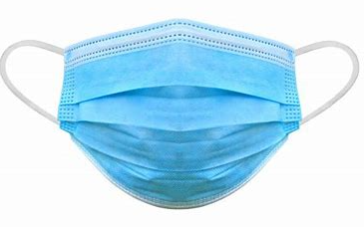
Accompaniment today
The accompaniment :
2011
7 shared waste collections
Confidential archives
Waste of electrical and electronic equipment
Print cartridges
Batteries
Papers - Cardboards
Hydrocarbon separators
Hazardous waste
2020/2021
Development of a pooled collection single-use surgical masks

Slide 10
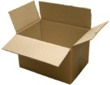
Example of waste grouping Papers
Objectif : have a shared service for the benefit of the participants
Company B
Company C
Company A
Carrier
Company D
Recycling

Slide 11
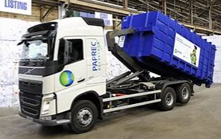
Example of waste grouping Archives
Setting up the service :
Identification of deposits and number of interested companies Identifying solutions proposed by waste treatment providers
Provider choice and service development
How archives are valued ? :
Ecopal informs companies of the day of the transport and processing of archives Companies that need the service register with Ecopal
The carrier provides businesses with a 30M3 dumpster for one day Businesses come to deposit their archives in the dumpster At the end of the day, the carrier picks up the dumpster to process the archives by grinding. The crushed paper is baled to be sent to paper recycling plant in the Hauts de France region for recycling.

Slide 12
In 2020
Cardboard paper : 56 participating structures – 115,74 Tonnes valued – 104 Transports Hazardous wastes : 57 participating structures – 150,815 Tonnes valued – 52 Transports
Confidential archives : 14 participating structures – 15,74 Tonnes valued – 2 Transports
Wastes of electrical and electronic equipment : 7 participating structures – 2 Transports
Cartridges : 15 participating structures – 2 Transports
Batteries : 10 participating structures – 250 kg valued
hydrocarbon separators : 2 participating structures – 1 Transport

Slide 13
Thank you for listening

